Slide 1
Psychology Seminar Project
June 2023

Slide 2
Introduction
The study of the mechanism behind face recognition is still hotly debated.
Two main theories : domain-specific and general-expertise
Evidence for “face-specific” phenomena in experiments
Inversion effect (Yin et al., 1969)

Slide 3
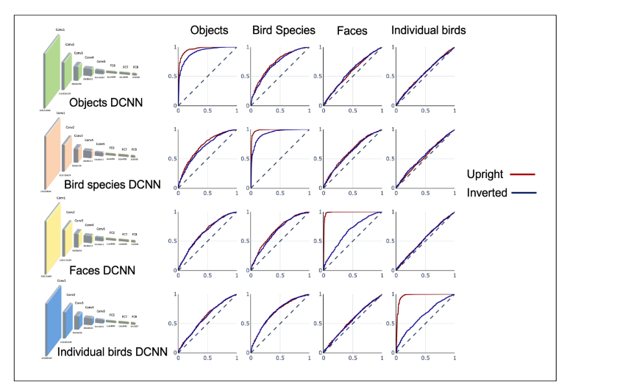
Introduction
But how do we “isolate” exposure to stimuli from specific domain?
One option – simulating by DCNNs
Yovel G., Grosbard I. & Abudarham N., 2022

Slide 4
Introduction
Two categories of recognition:
Individual-level: faces, individual birds
Subordinate-level: objects, bird species
So why hands?
Individual-level
T-shape stimuli
Source of variance between identities

Slide 5
Introduction
Experiment 1: Inversion effect in DCNNS
Research hypothesis: Inversion effect will be reproduced also for hands, and faces will not be better in recognizing hands than recognizing other domains
Experiment 2: Finetuning
Research hypothesis: When fine-tuning models trained on objects or faces for hands domain, faces model will not outperform objects model.

Slide 6
Experiment 1 – Inversion effect

Slide 7
Measuring Inversion effect

Slide 8
Measuring Inversion effect
ROC curve -
true positive rate (TPR) against false positive rate (FPR)
Probability
1
0
dists

Slide 9
Measuring Inversion effect
ROC curve -
true positive rate (TPR) against false positive rate (FPR)
Is different?
1
– Actual –
 | Same | Different
Same | TPR | FPR
Different | FNR | TNR
0.5
| Predicted |
0
dists

Slide 10


Measuring Inversion effect
ROC curve -
true positive rate (TPR) against false positive rate (FPR)
What we expect in domain expert model?
What do we expect in non-expert?
TPR
FPR

Slide 11
Measuring Inversion effect
ROC curve -
true positive rate (TPR) against false positive rate (FPR)
What we expect in domain expert model?
What do we expect in non-expert?
The area under the curve is called AUC
1
TPR
AUC
FPR
1

Slide 12
Measuring Inversion effect
ROC curve -
true positive rate (TPR) against false positive rate (FPR)
Is different?
1
– Actual –
 | Same | Different
Same | TPR | FPR
Different
0.5
| Predicted |
0
dists

Slide 13
Measuring Inversion effect
ROC curve -
true positive rate (TPR) against false positive rate (FPR)
What we expect in domain expert model?
What do we expect in non-expert?
Is different?
1
– Actual –
 | Same | Different
Same
Different
0.5
| Predicted |
0
dists

Slide 14
Prob
Is different?
different
1
0.5
same
dists
0
dists
Is different?
1
0
dists

Slide 15
Background
Previous experiments on inversion effect…

Slide 16
Experiment 1
4 domains:
Faces
Objects
Hands:
Dorsal right hands
Both Hands
(Reminder: we are expecting to see something like this: )
Yovel G., Grosbard I. & Abudarham N., 2022

Slide 17
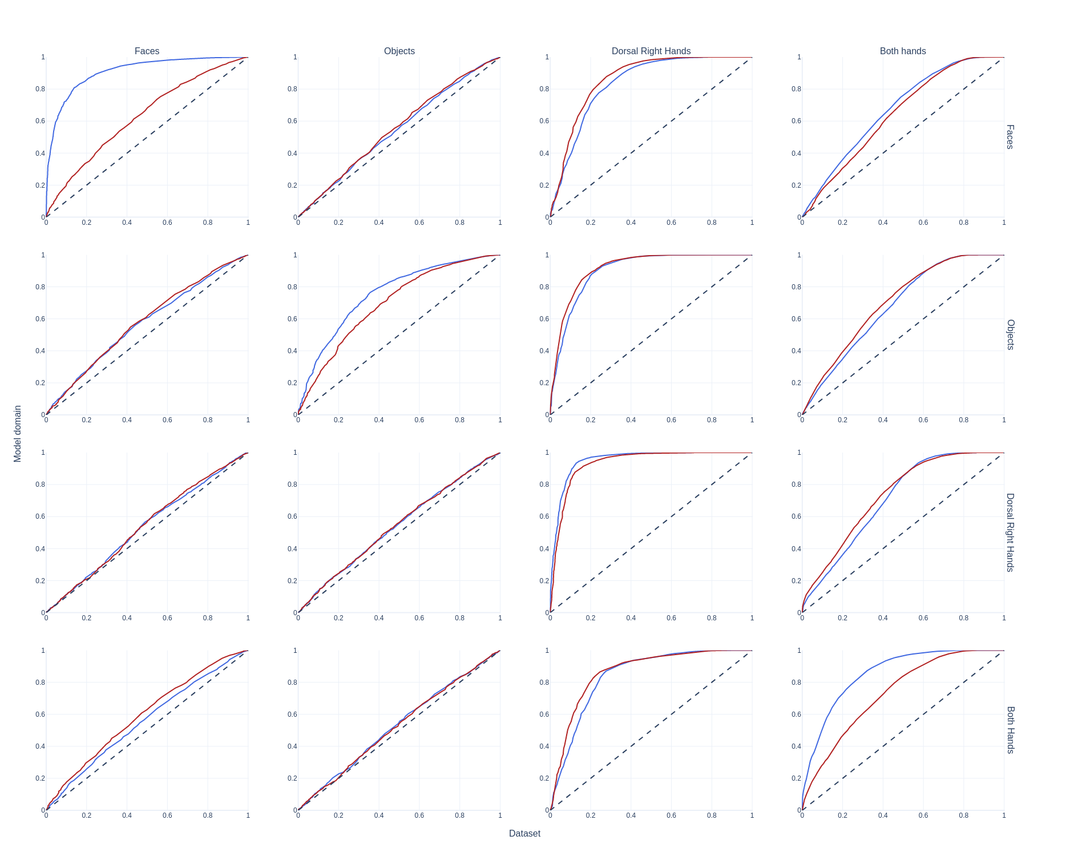
Experiment 1 – results?
Dorsal right pairs
Faces CNN

Slide 18
Experiment 1 – results?
Dorsal right pairs
Faces CNN
Objects CNN

Slide 19
Experiment 1 – results?
Dorsal right pairs
Faces CNN
Objects CNN
Dorsal right CNN
Both hands CNN

Slide 20
Experiment 1 – results?
Dorsal right pairs
Both hands pairs
Faces CNN
Objects CNN
Dorsal right CNN
Both hands CNN

Slide 21
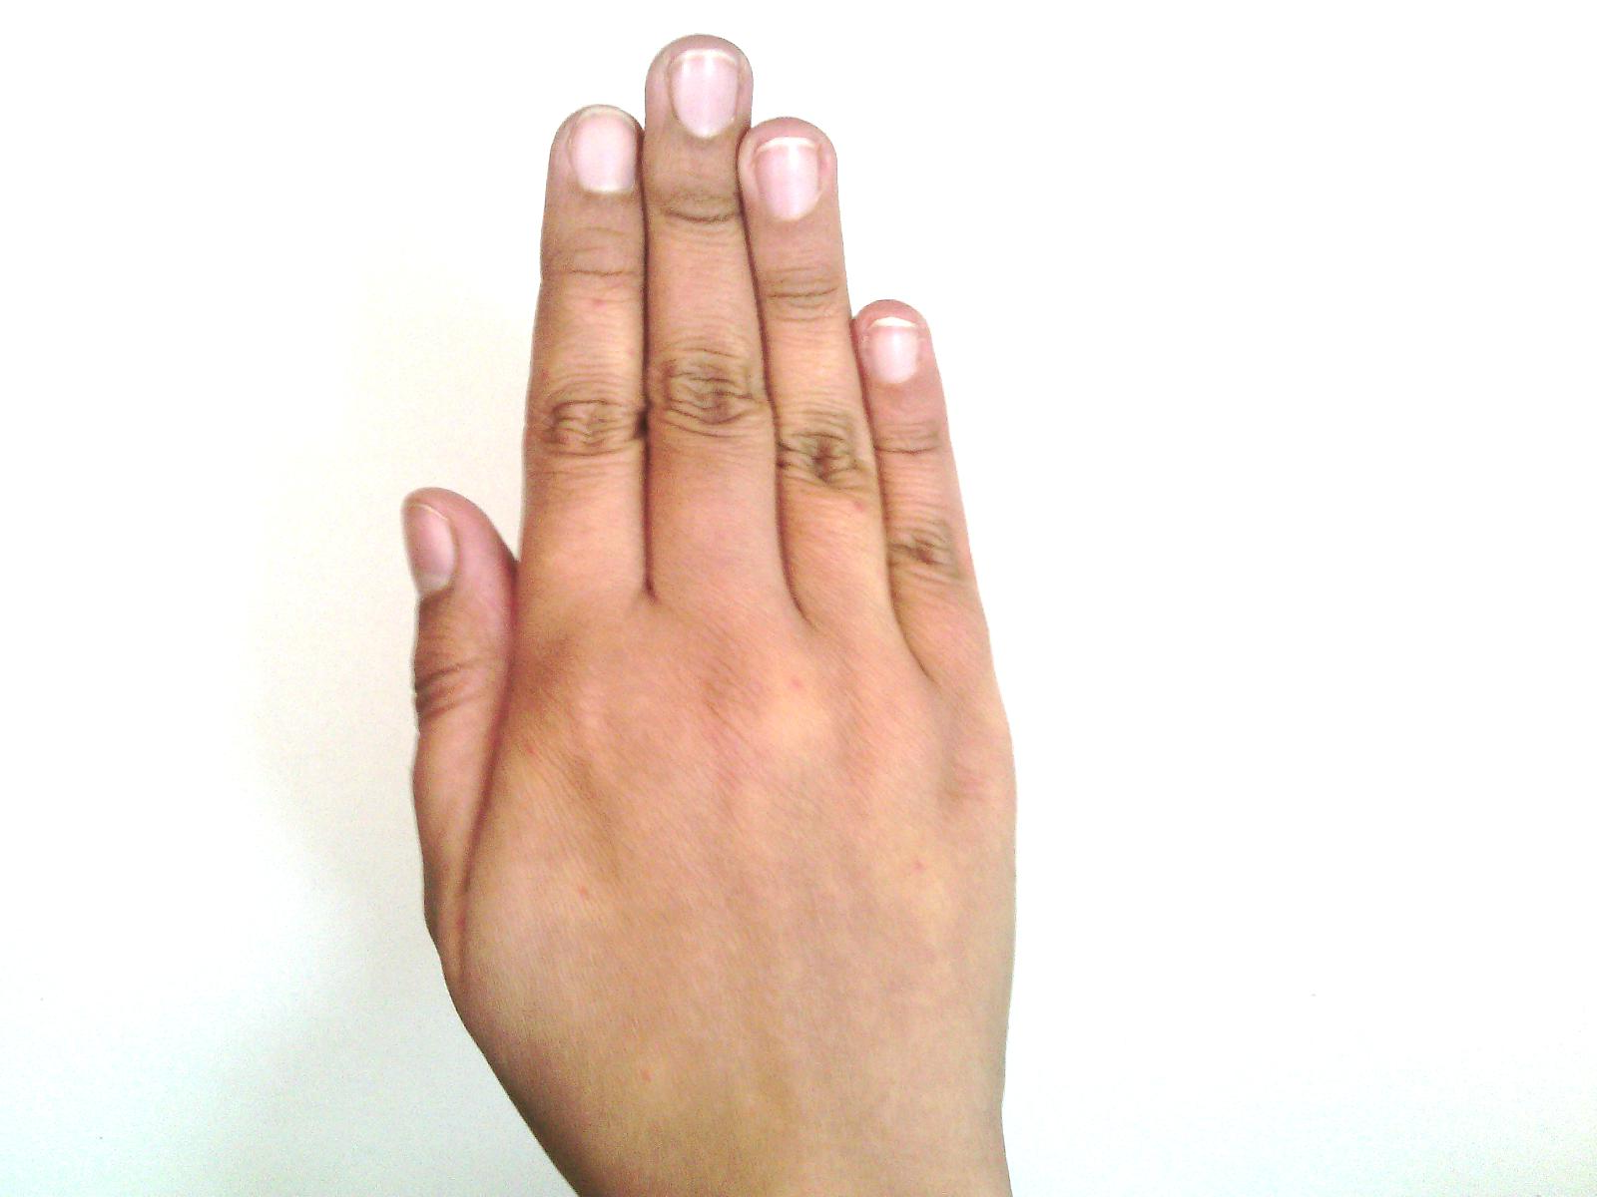
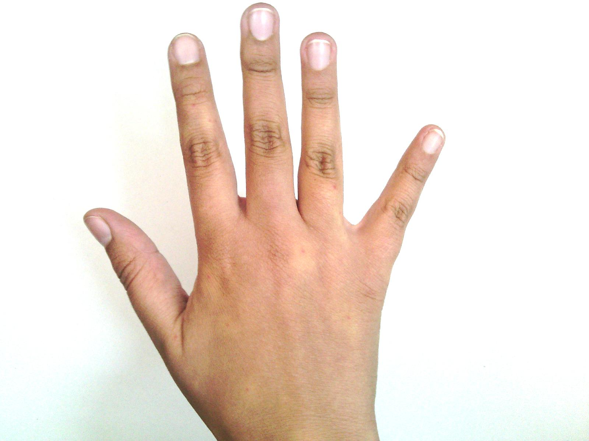
Experiment 1 – results?
Dorsal right pairs
Both hands pairs
Faces CNN
Objects CNN
Dorsal right CNN
Both hands CNN

Slide 22
Experiment 1 – results?

Slide 23
Experiment 1 – results?

Slide 24
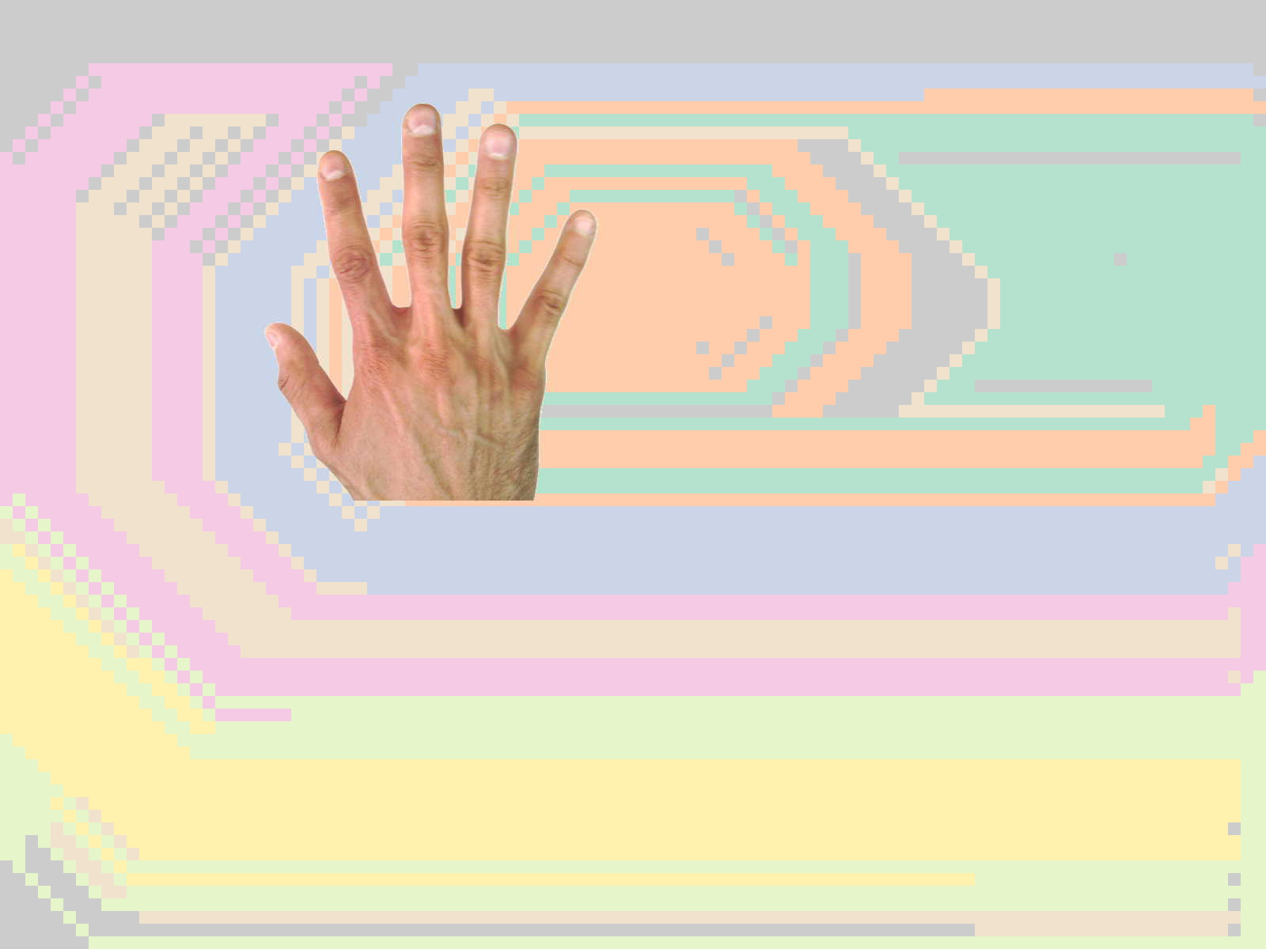
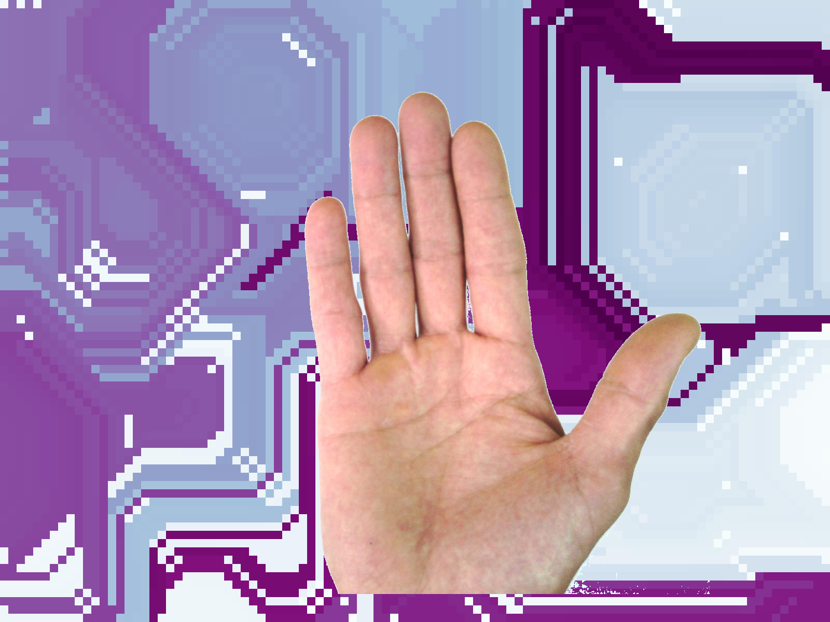
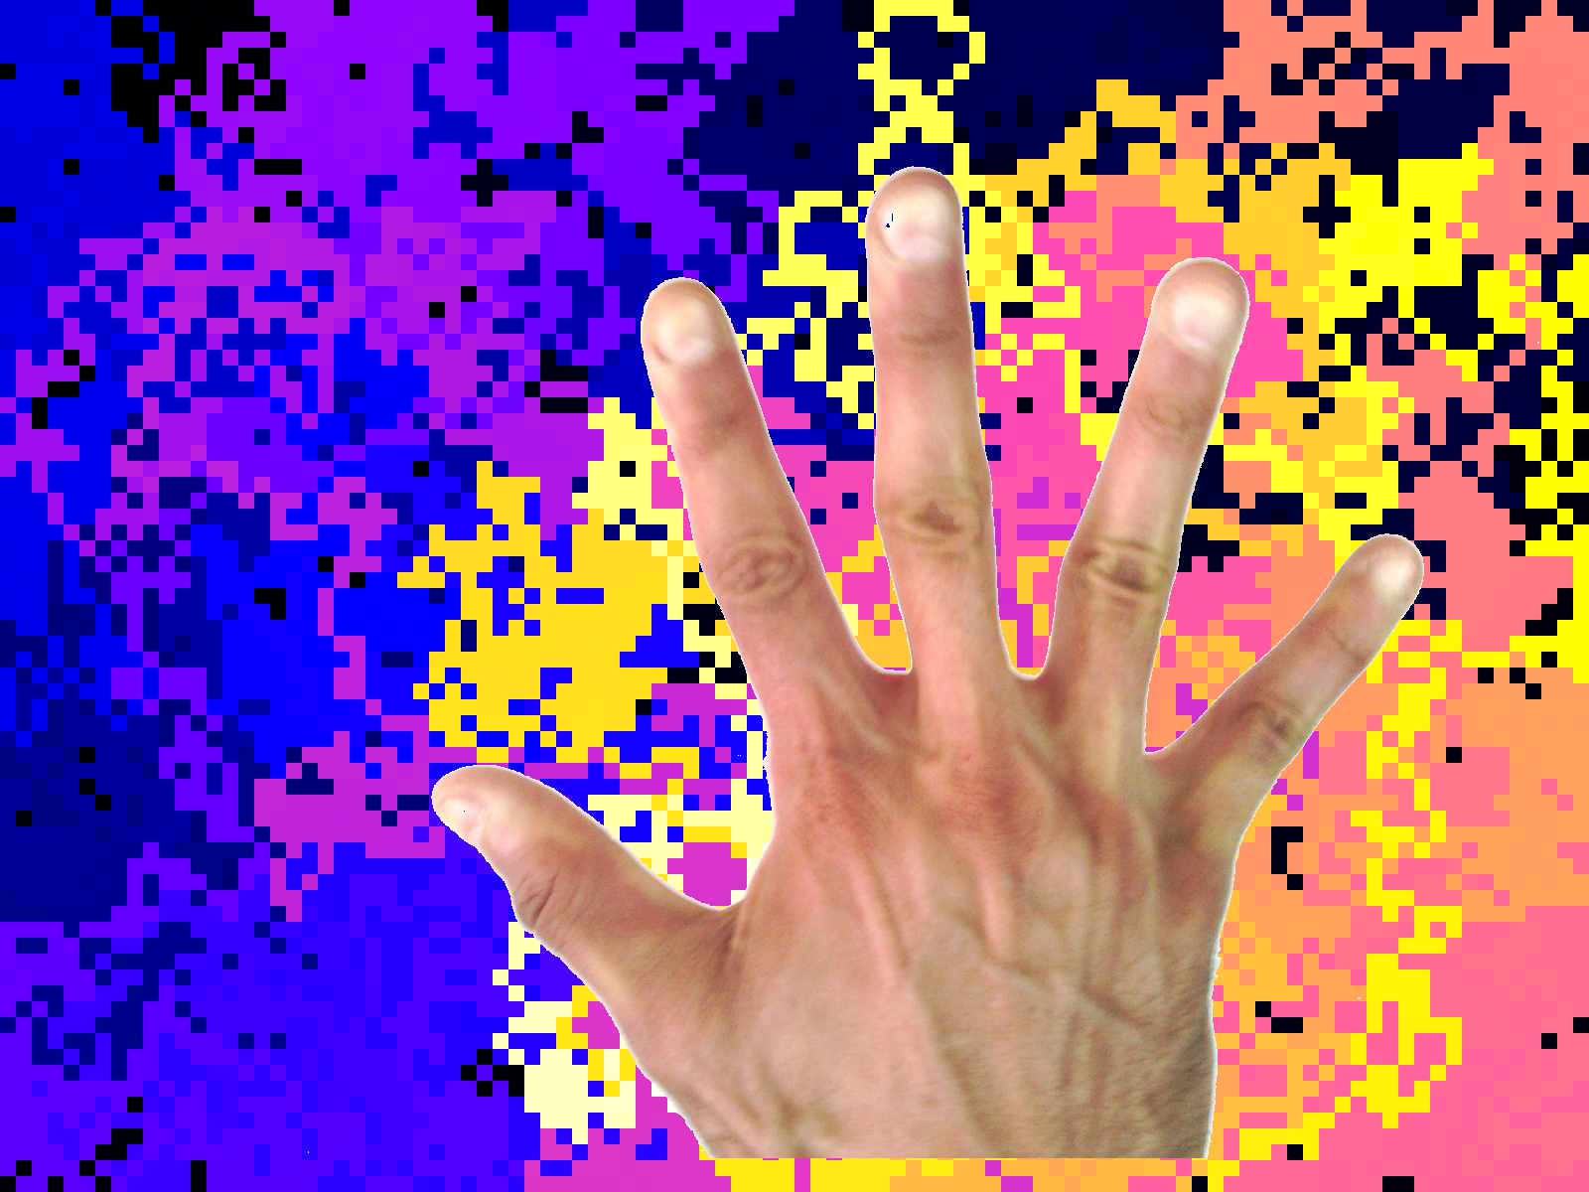
Hands dataset processing
Results of faces net for dorsal right and both hands – compared t

Slide 25
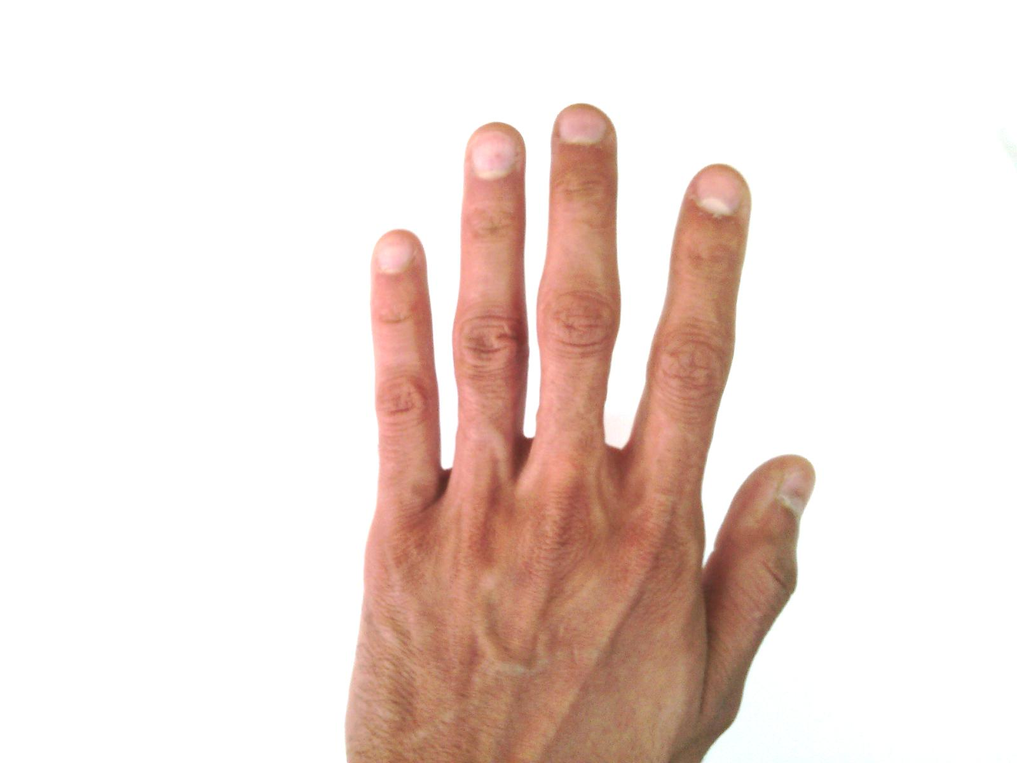
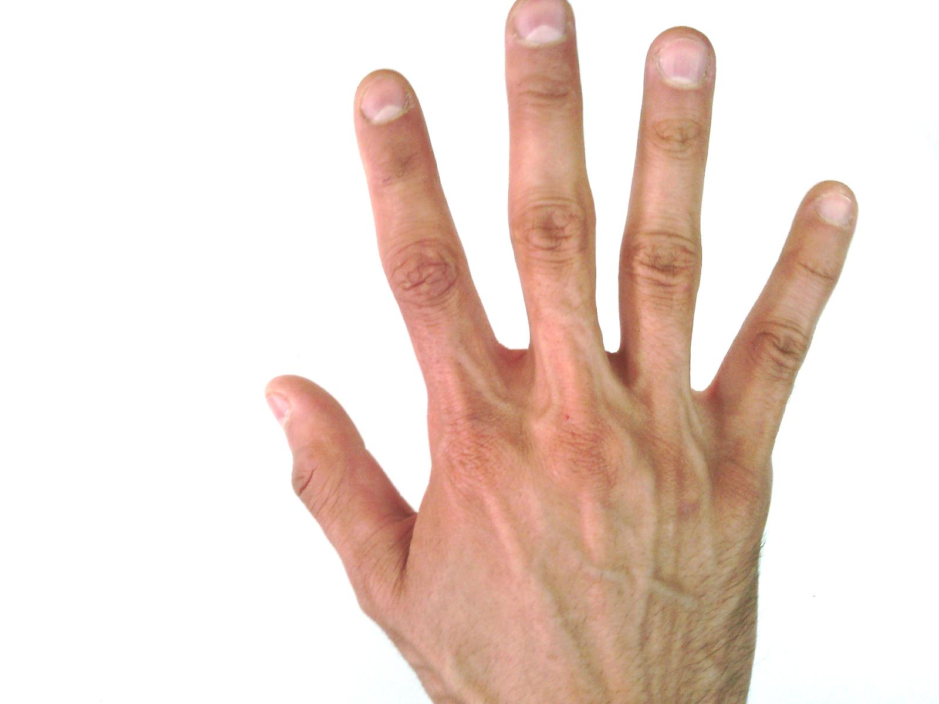
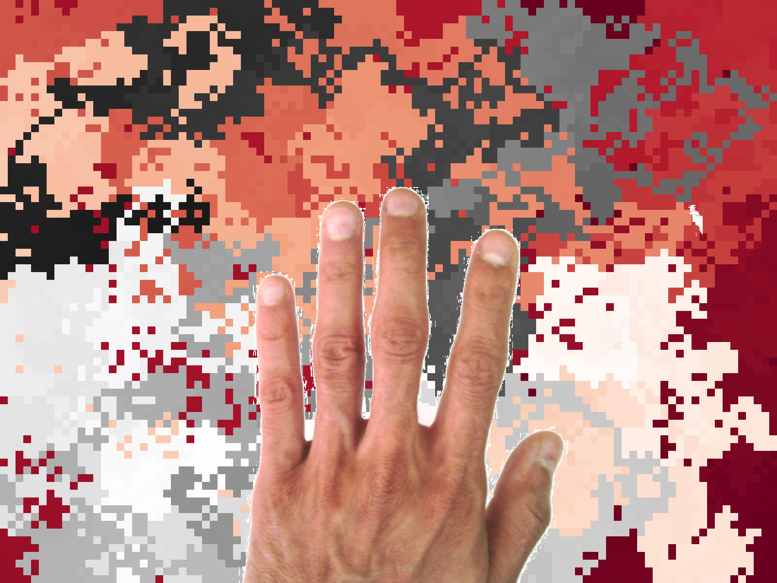
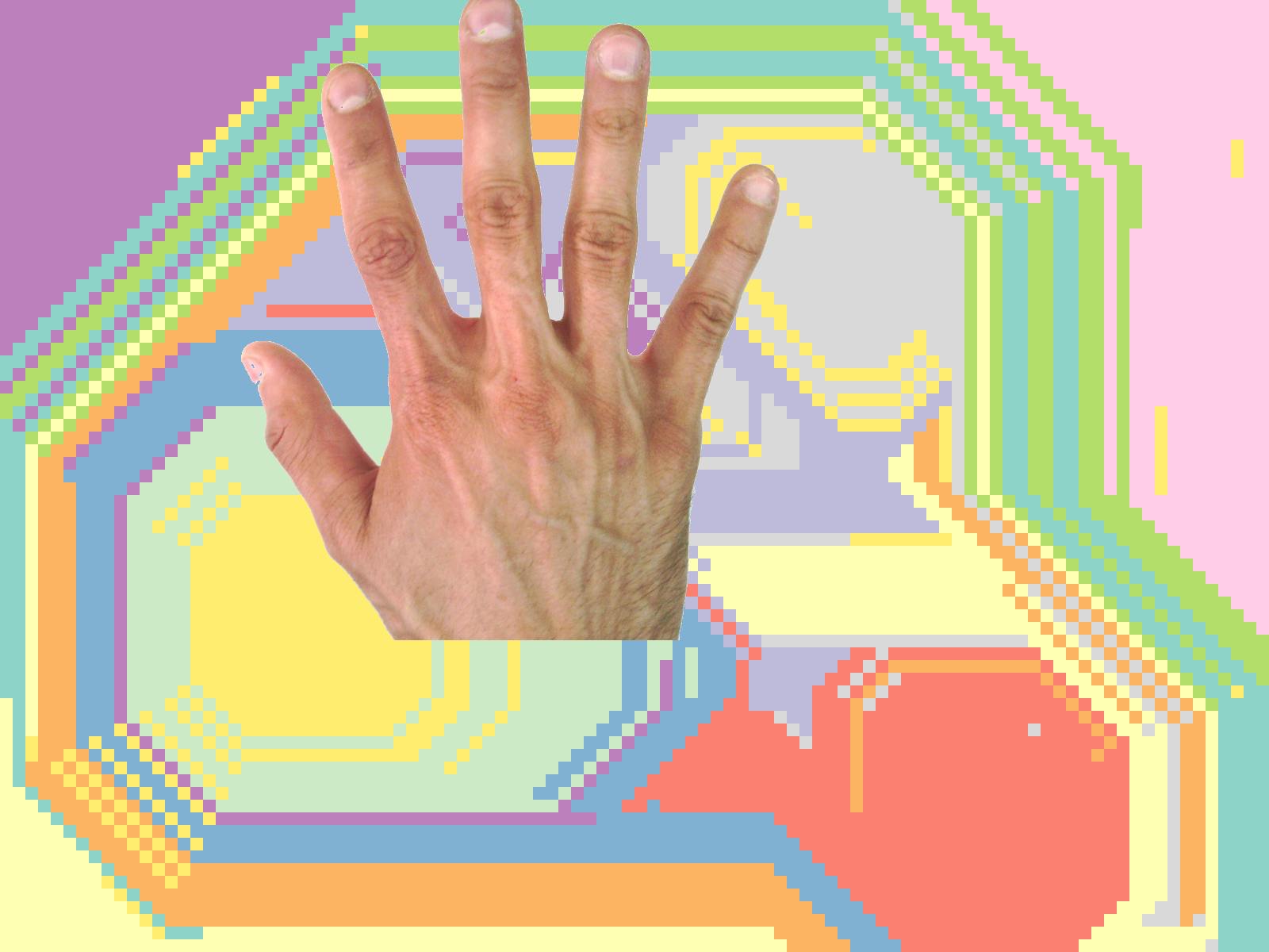
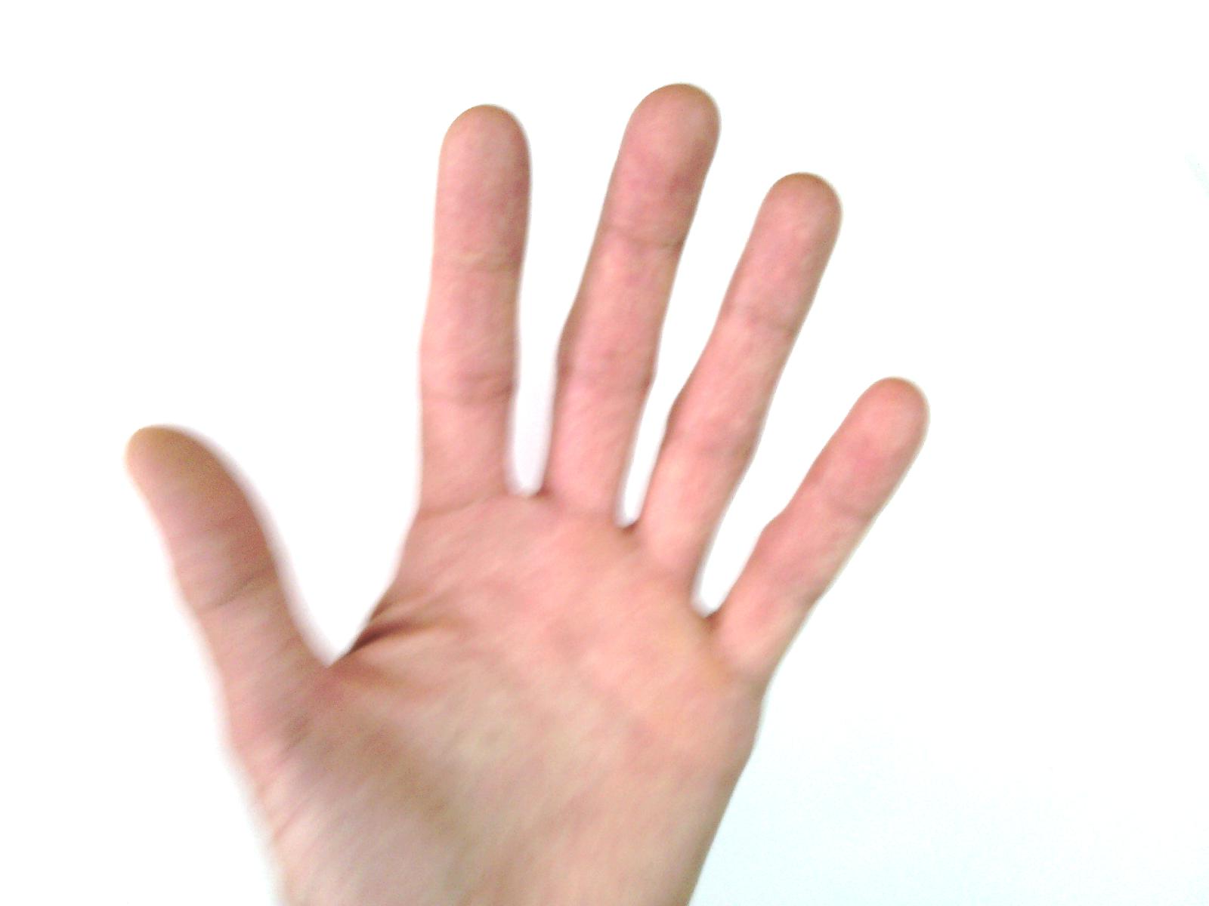
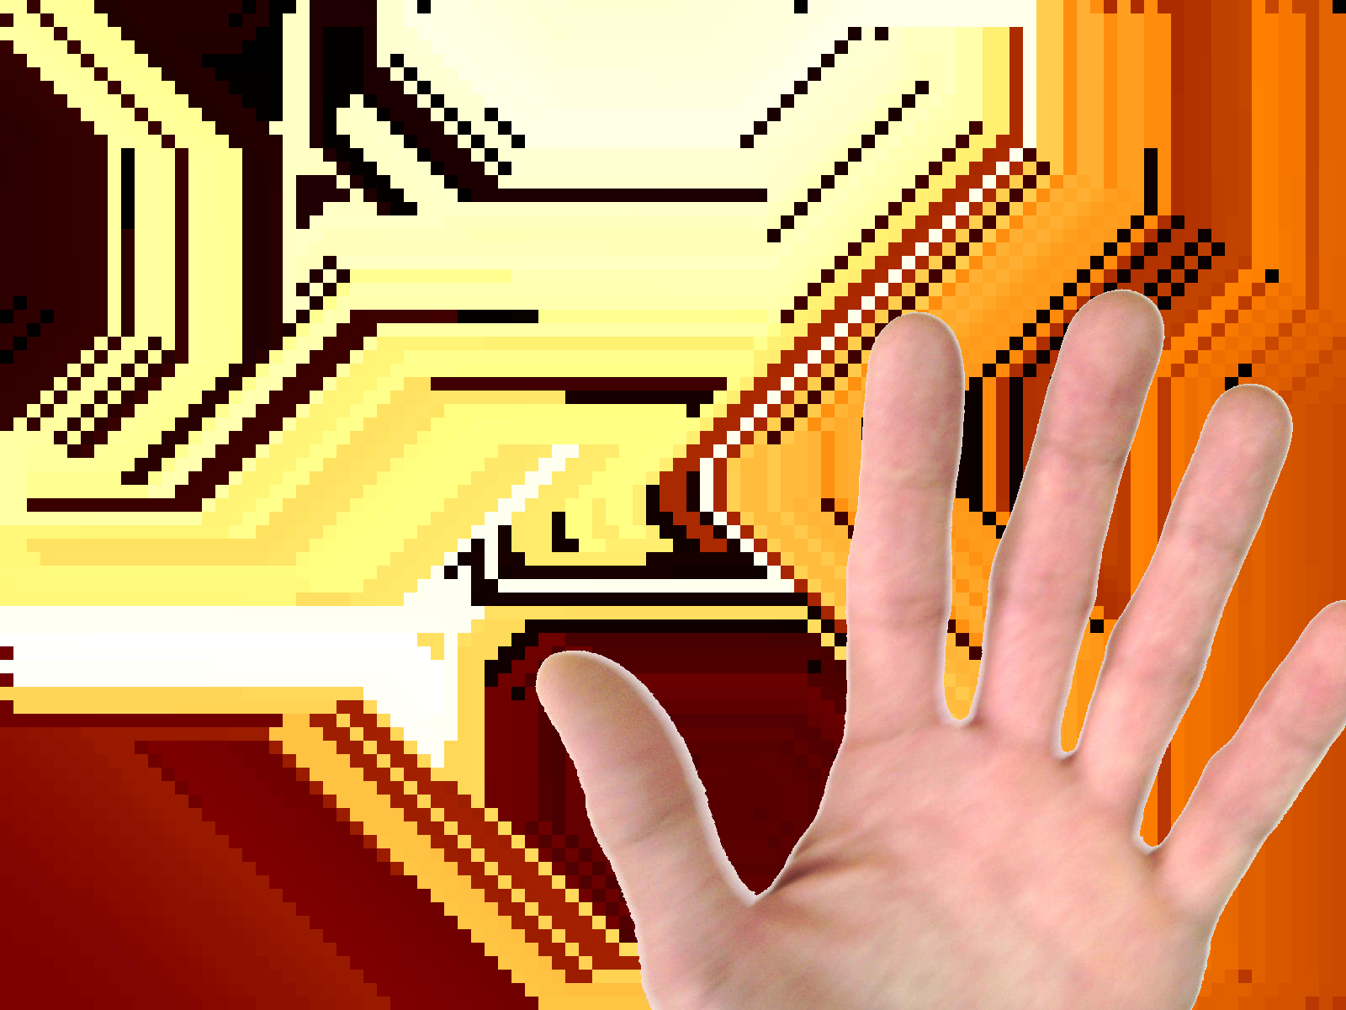
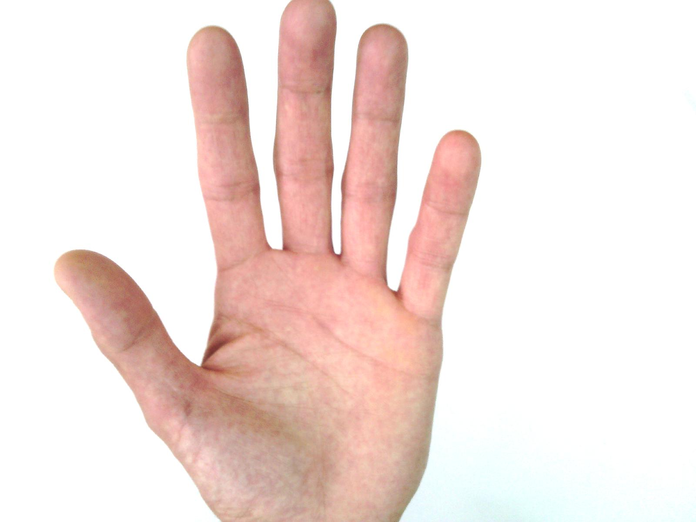
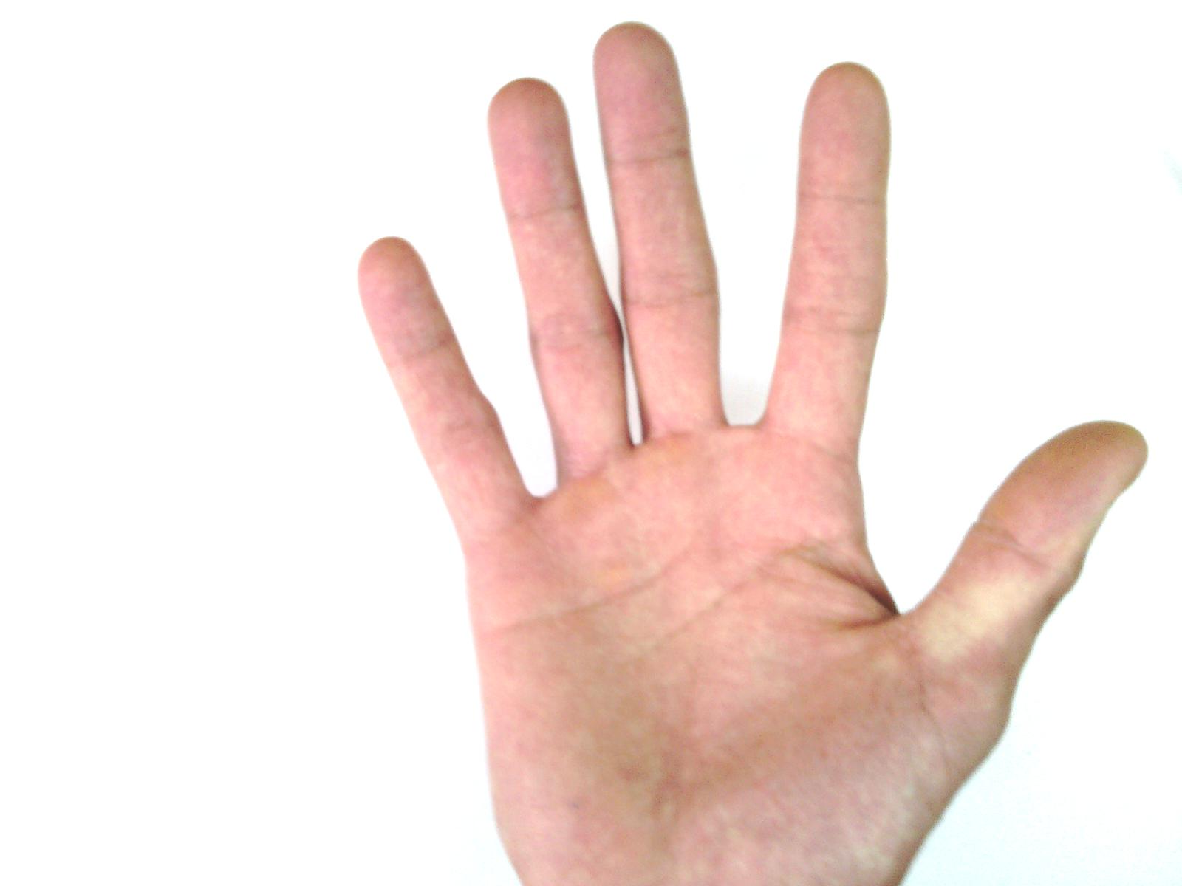

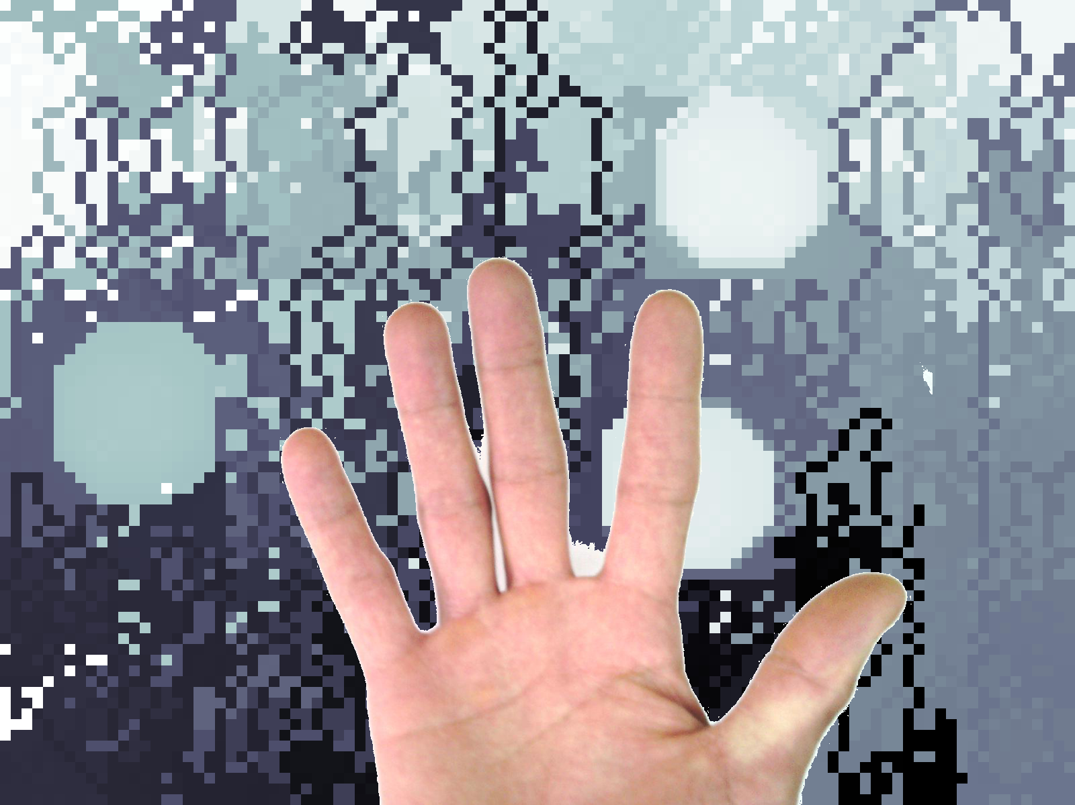
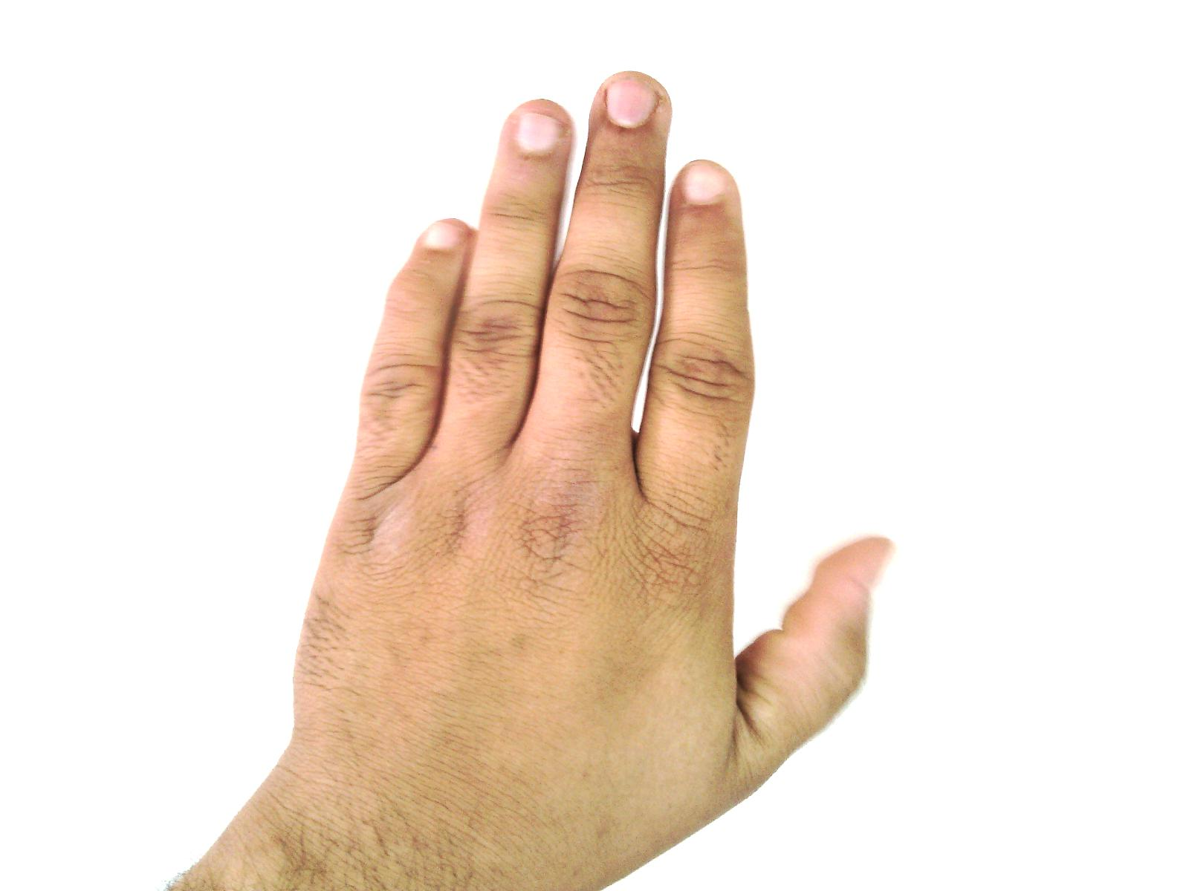
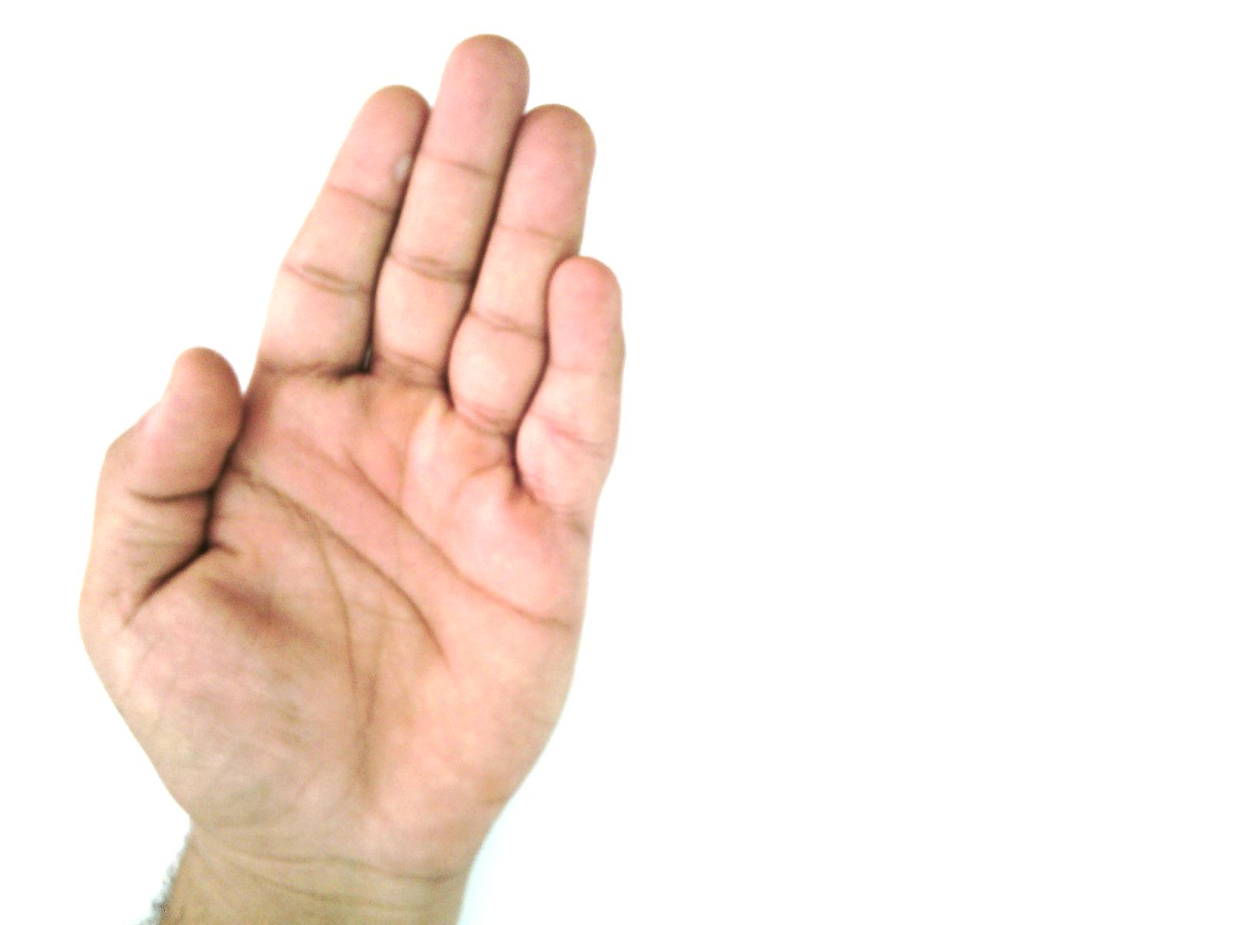
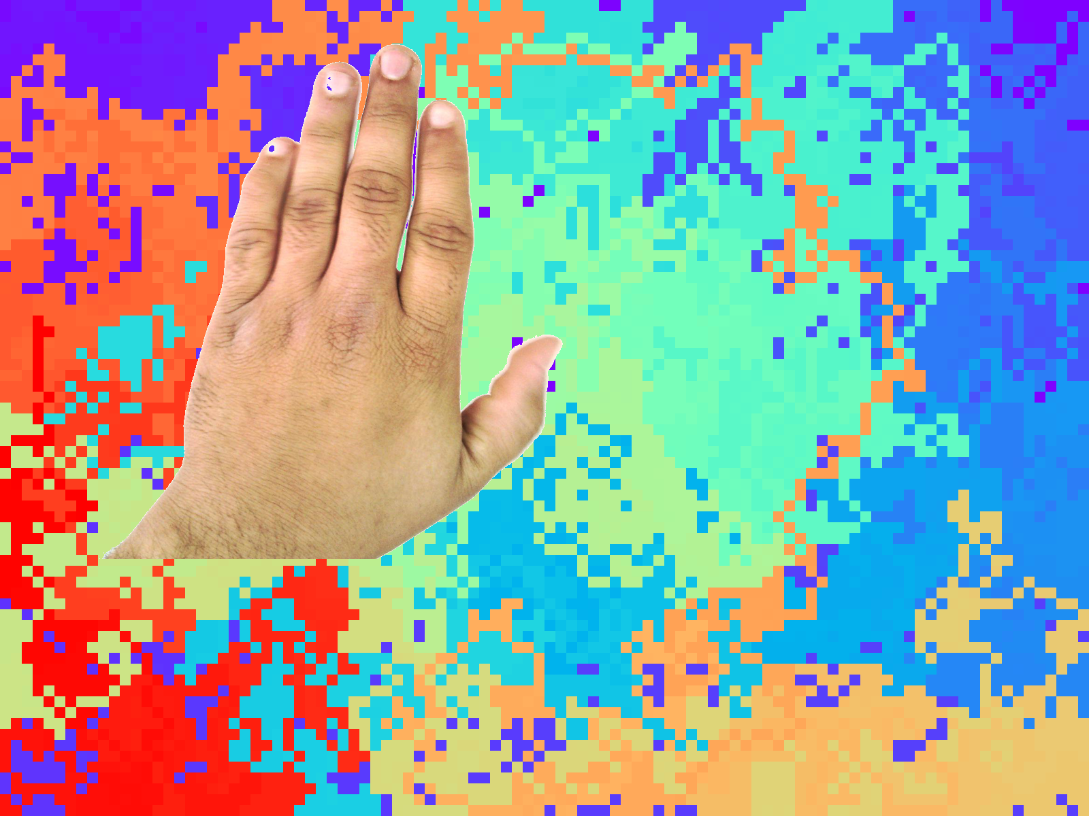
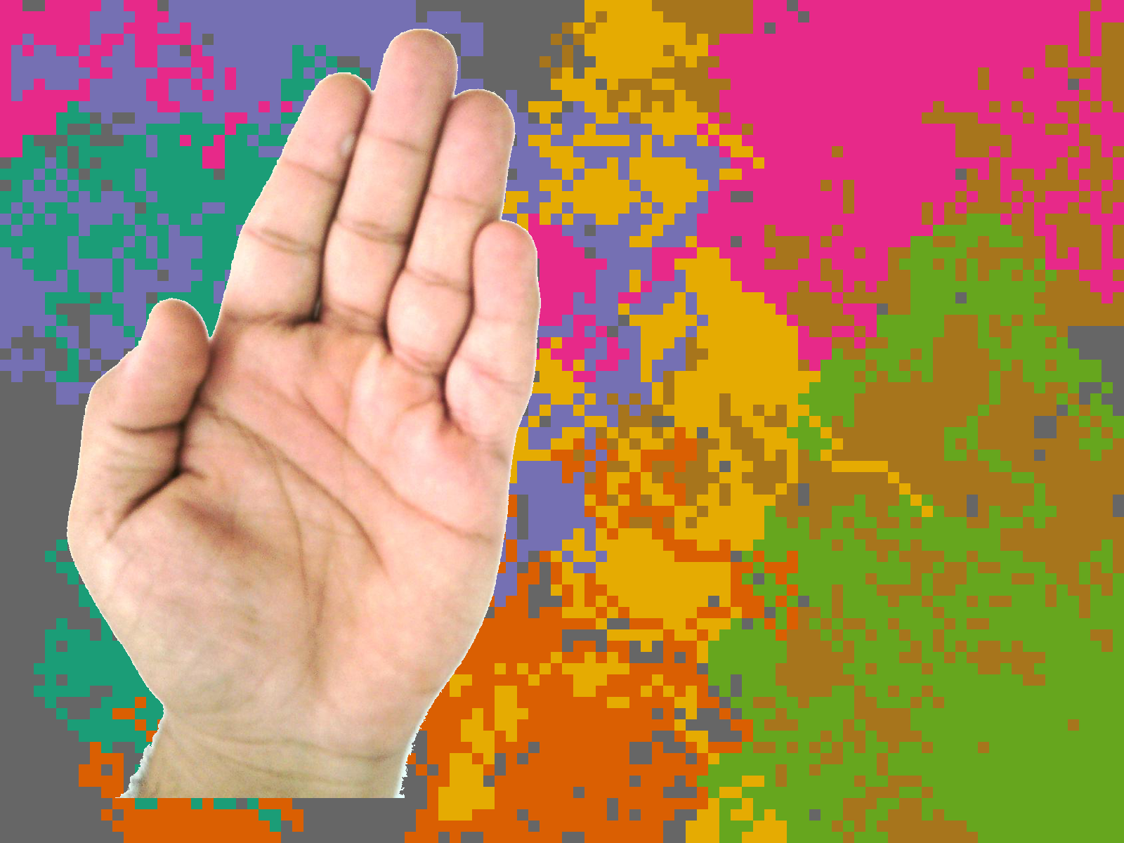
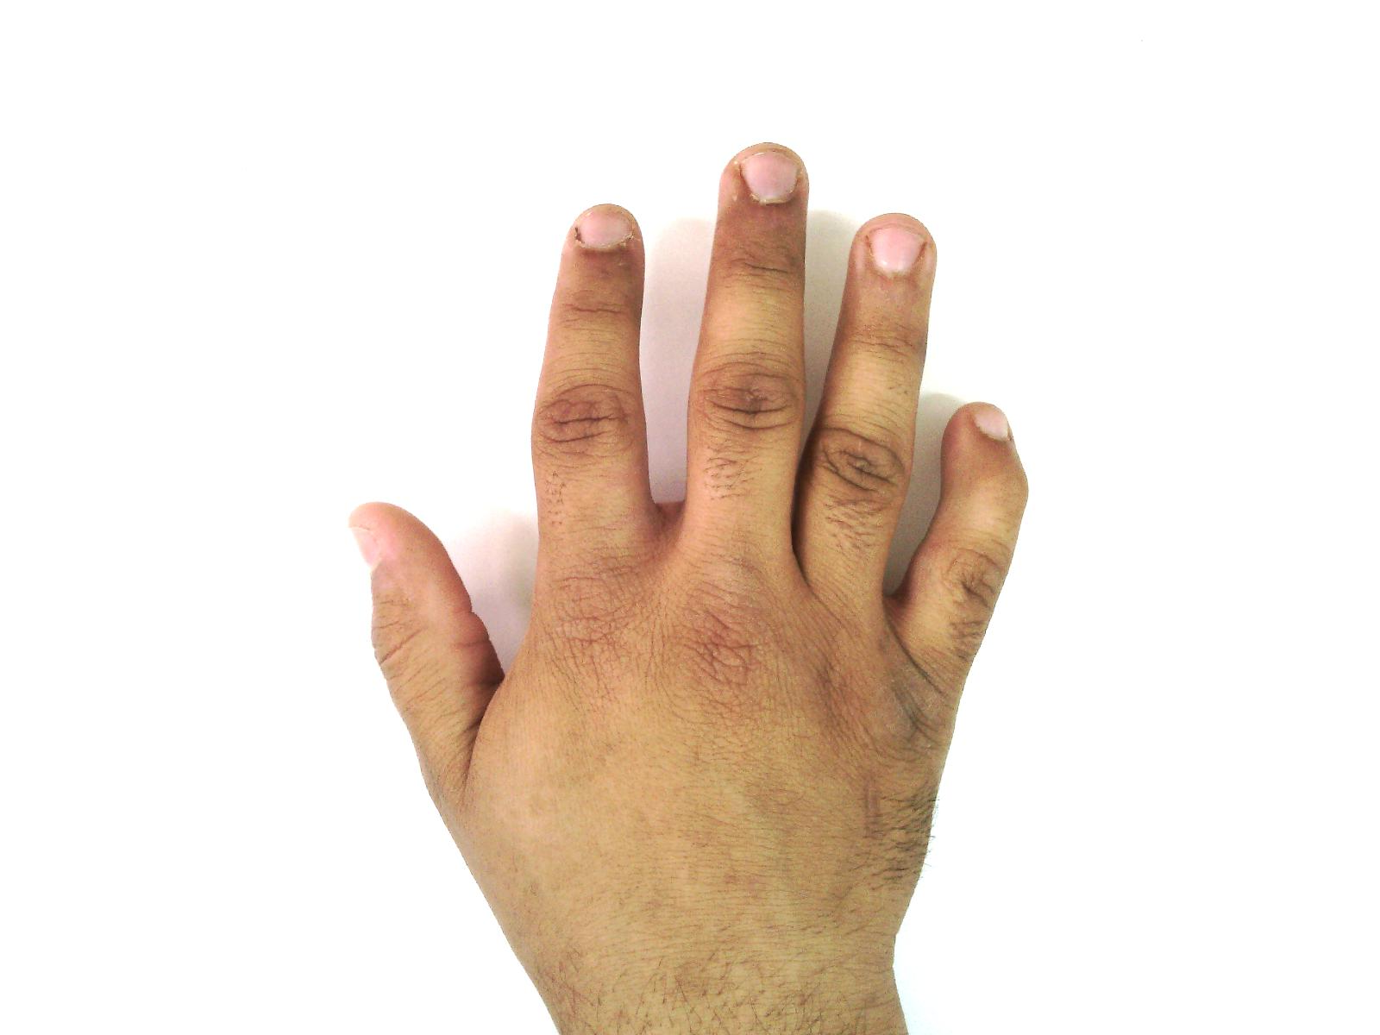
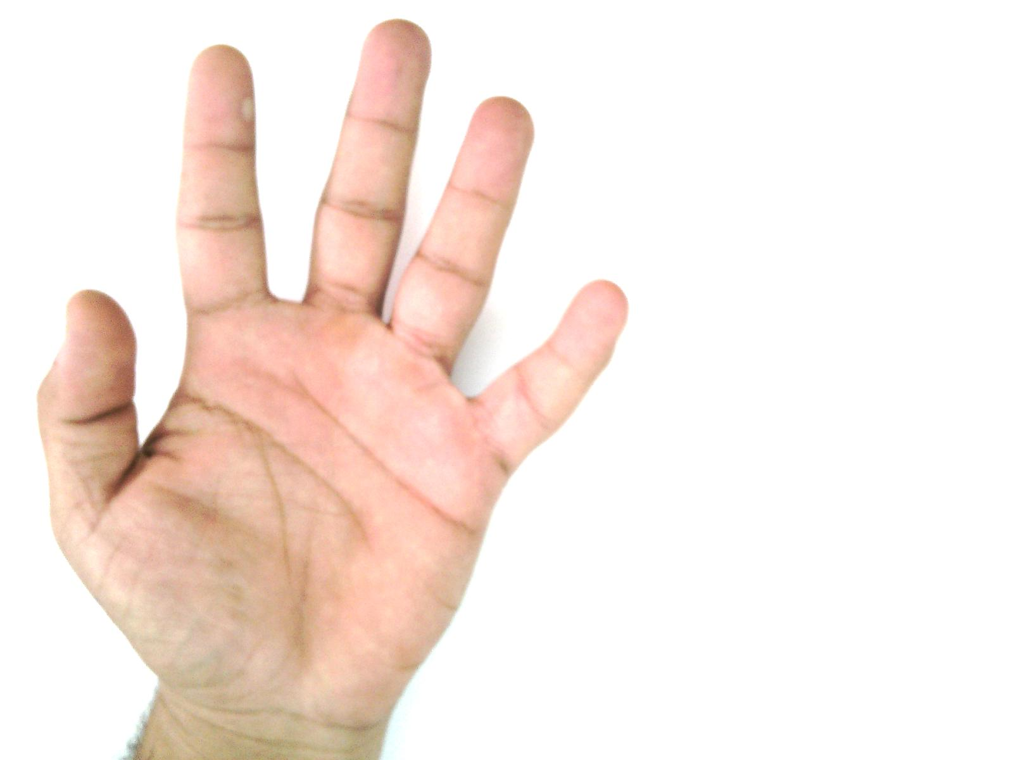
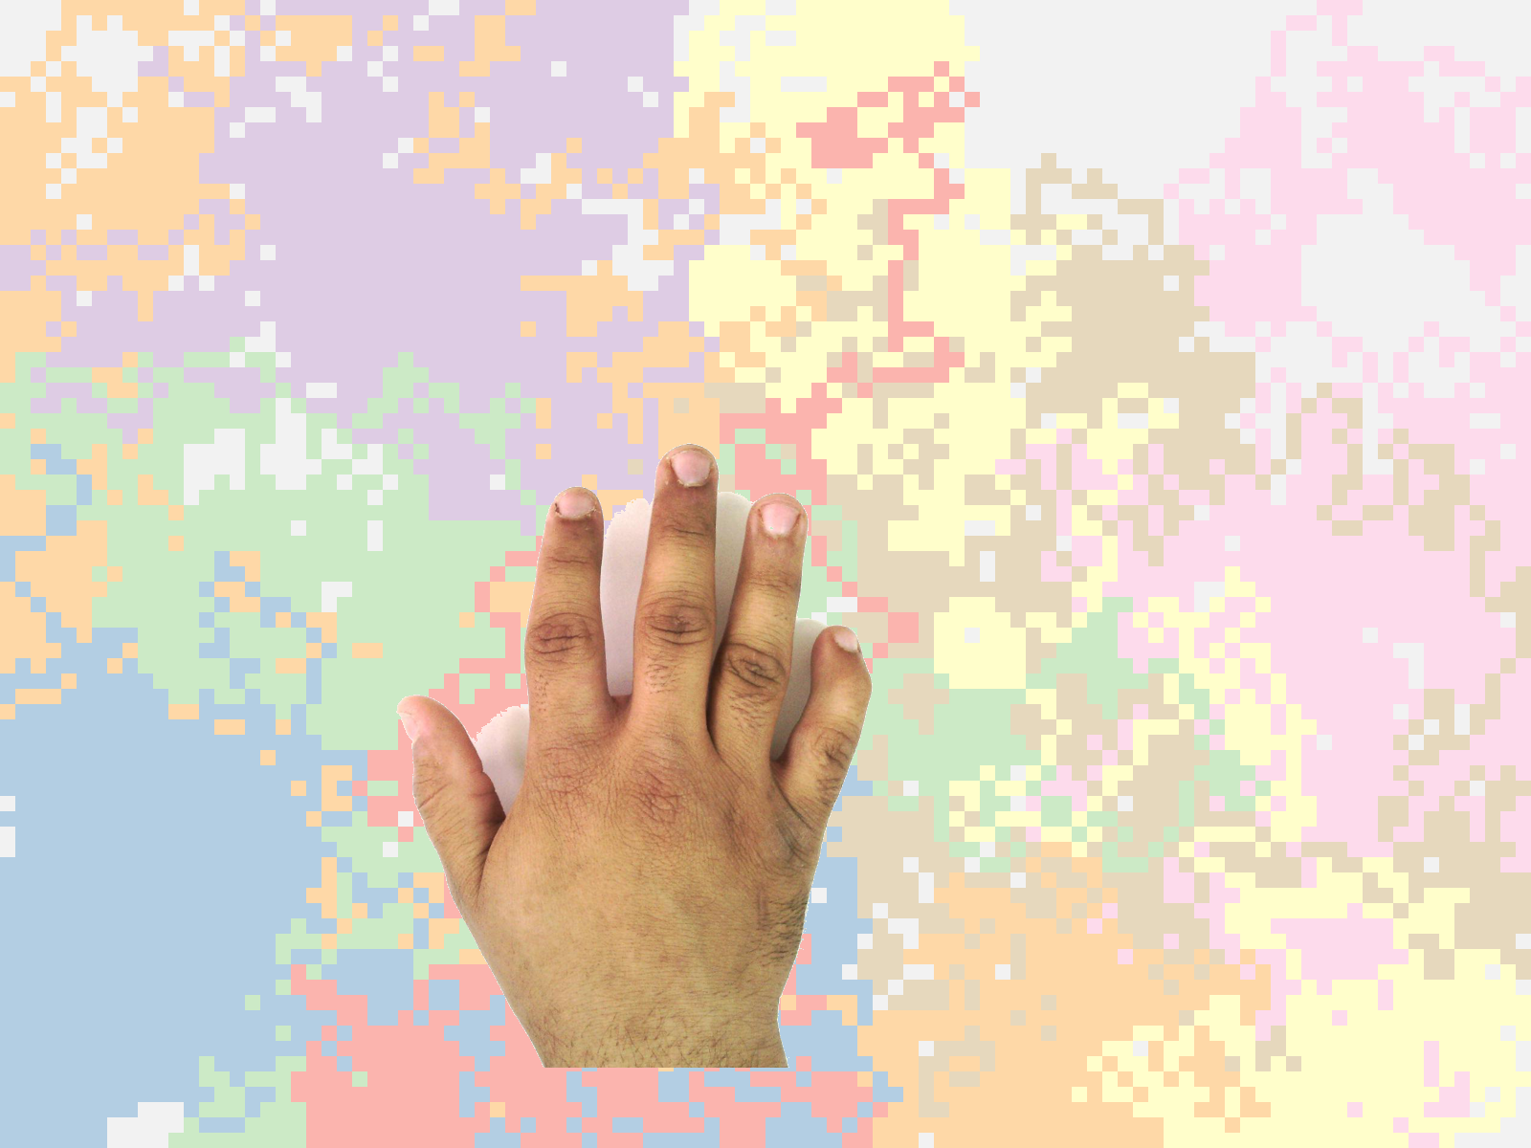
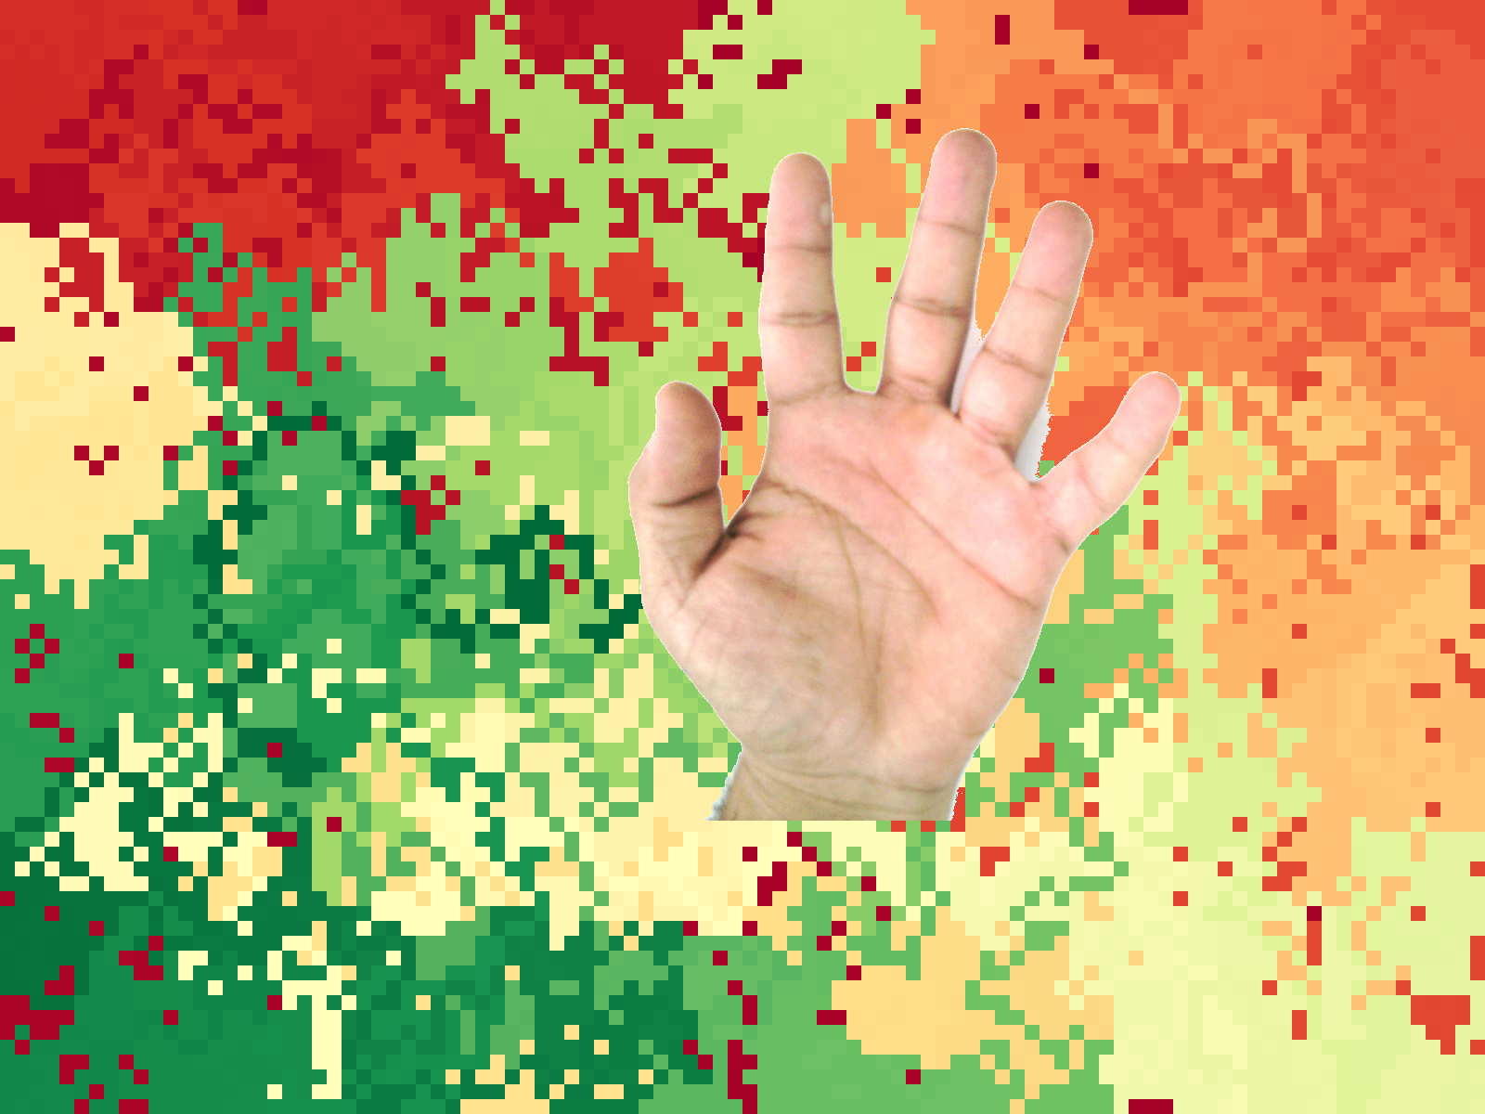

Slide 26
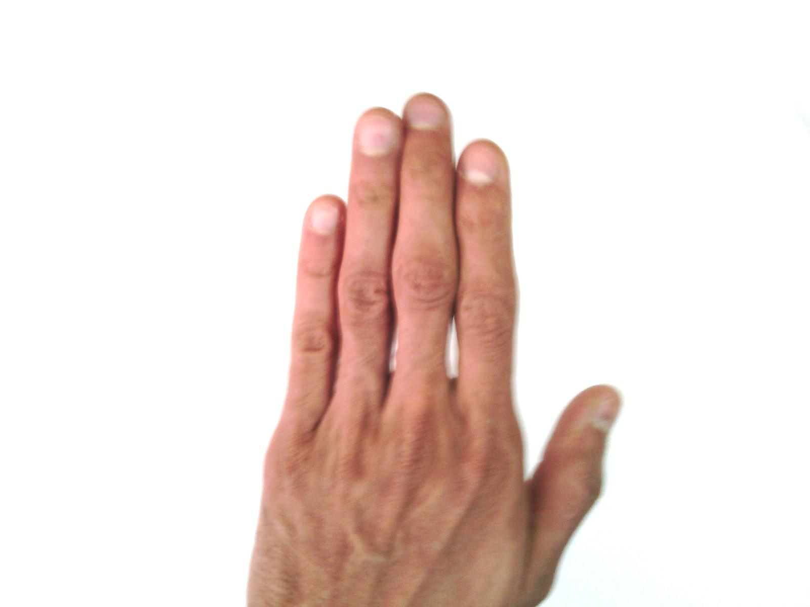
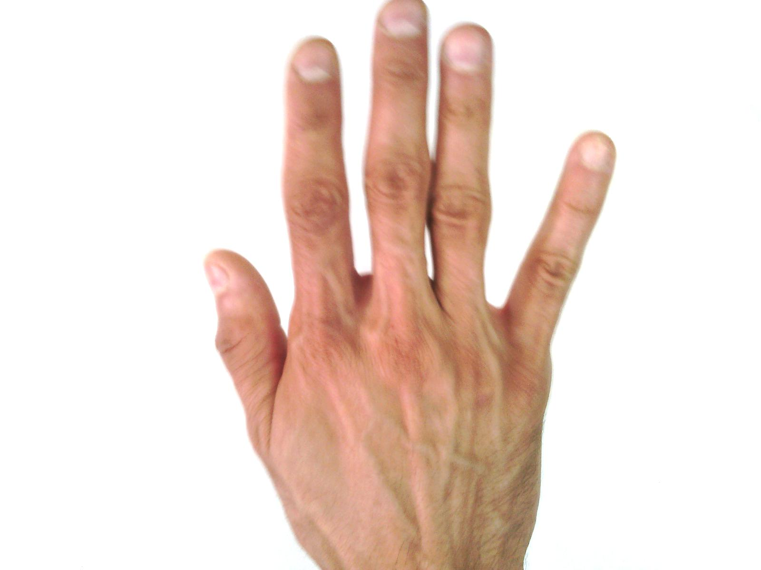
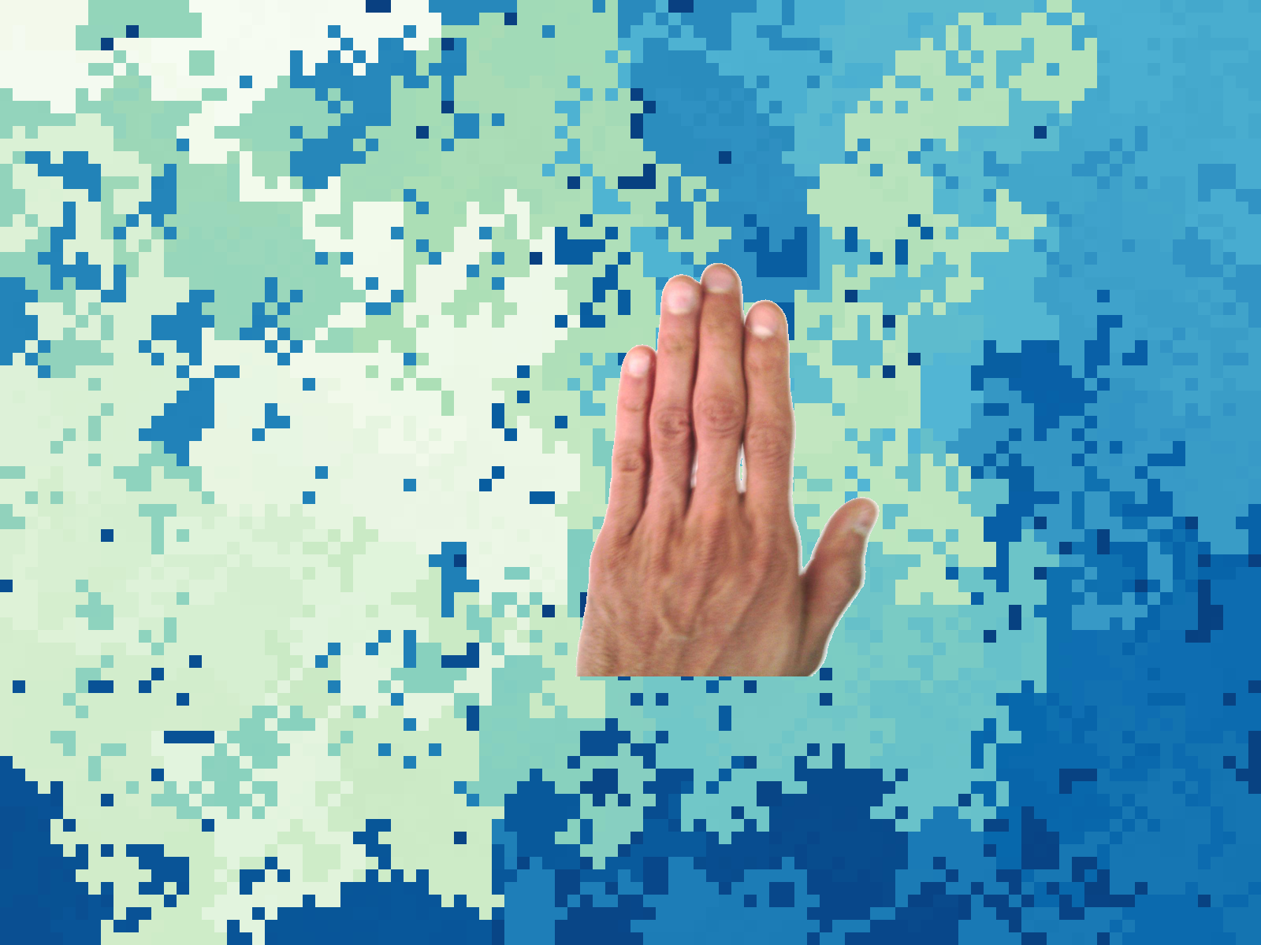
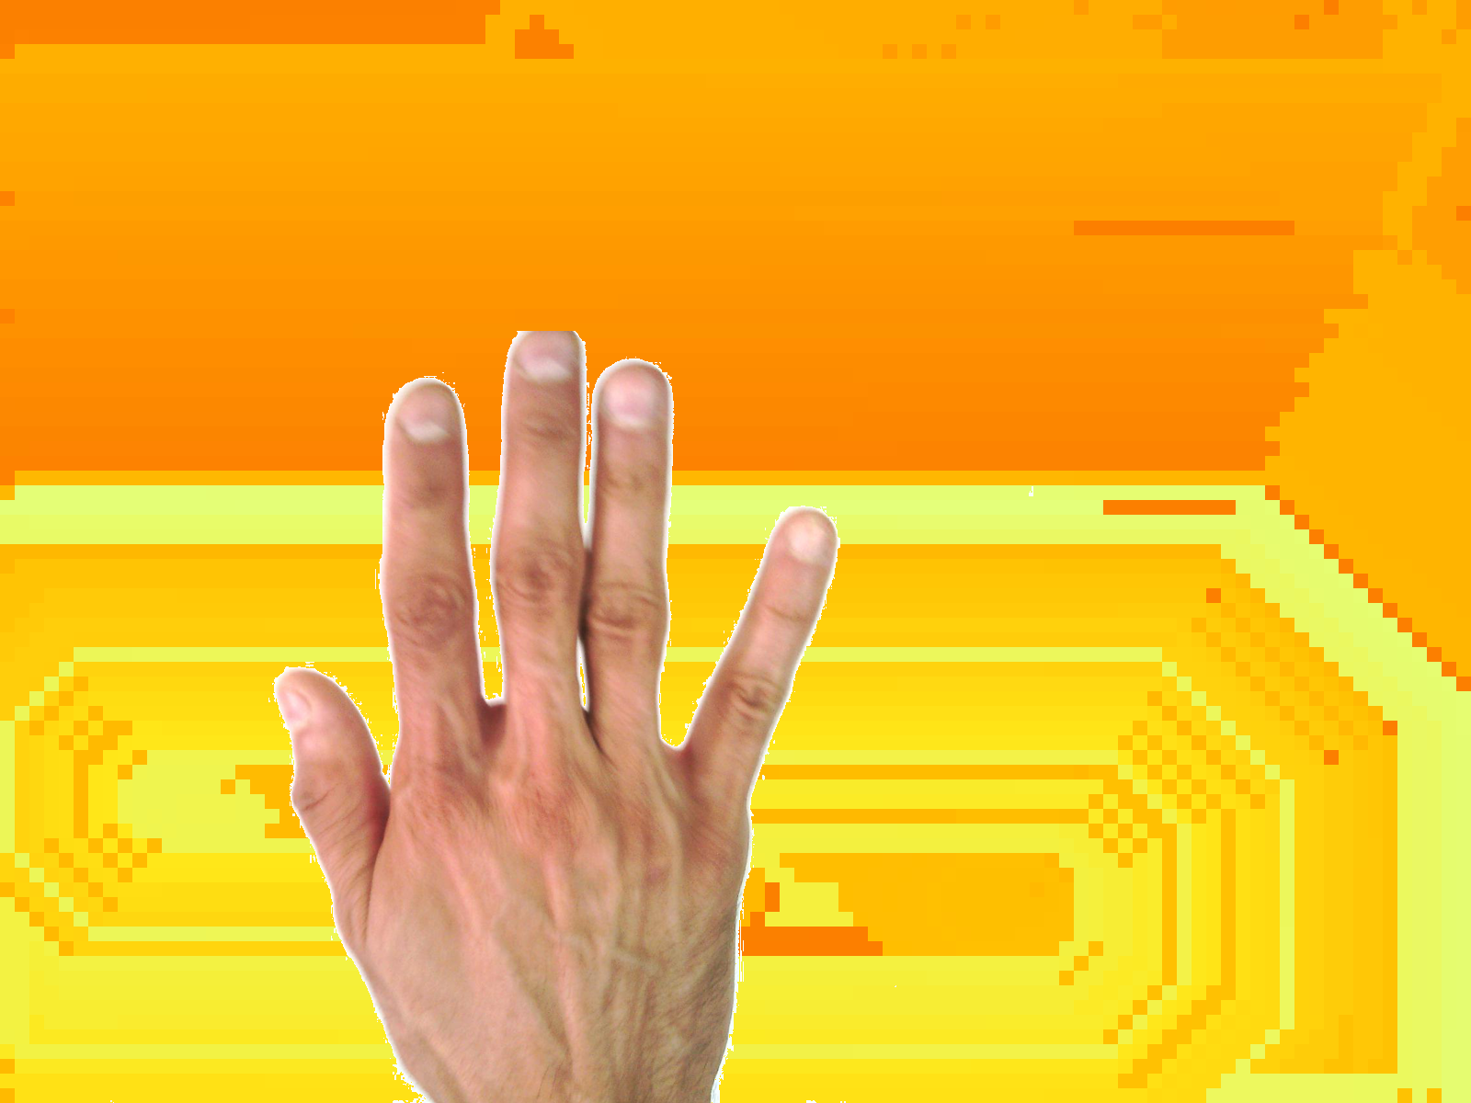
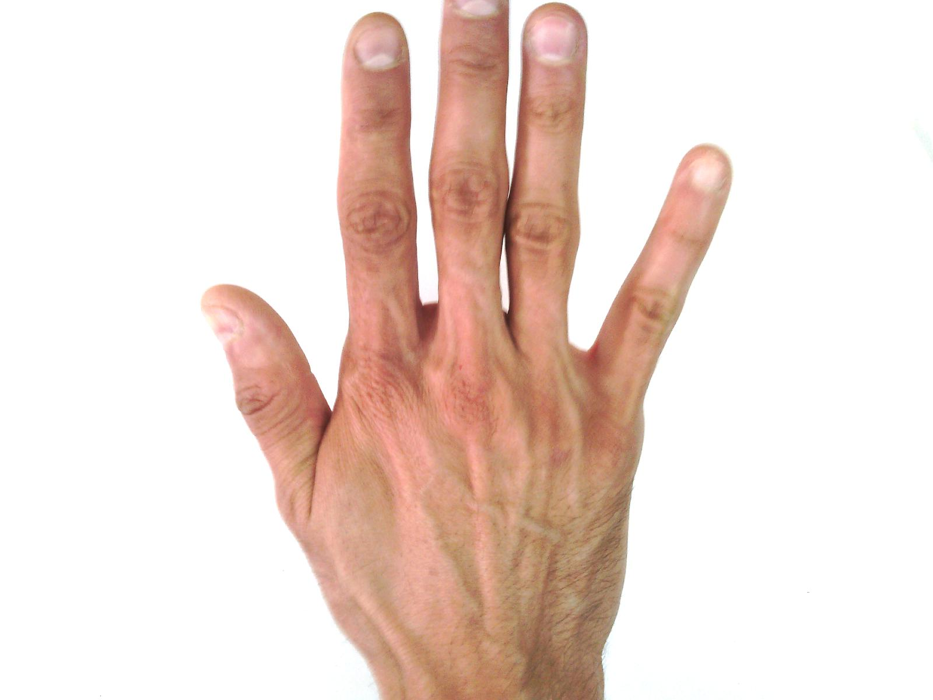
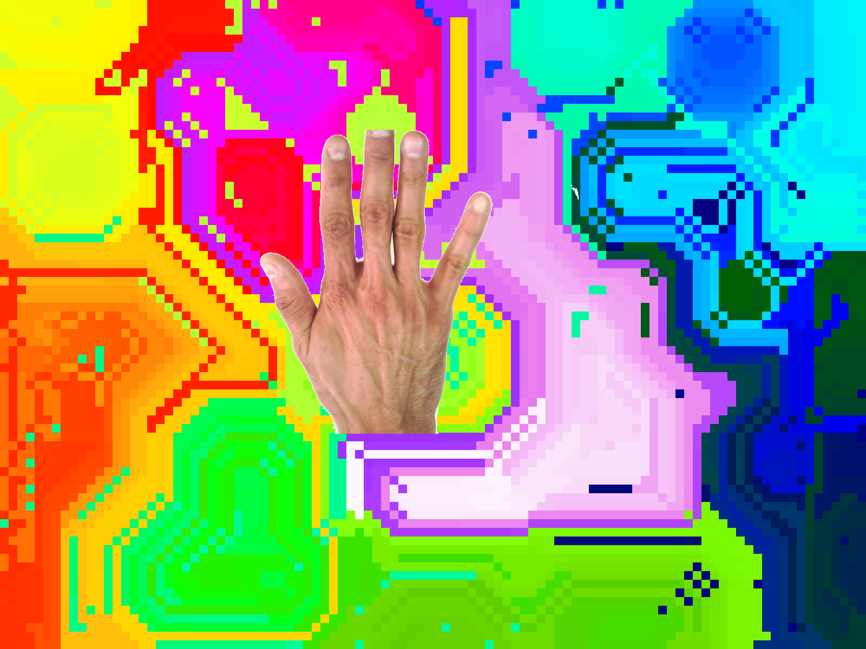
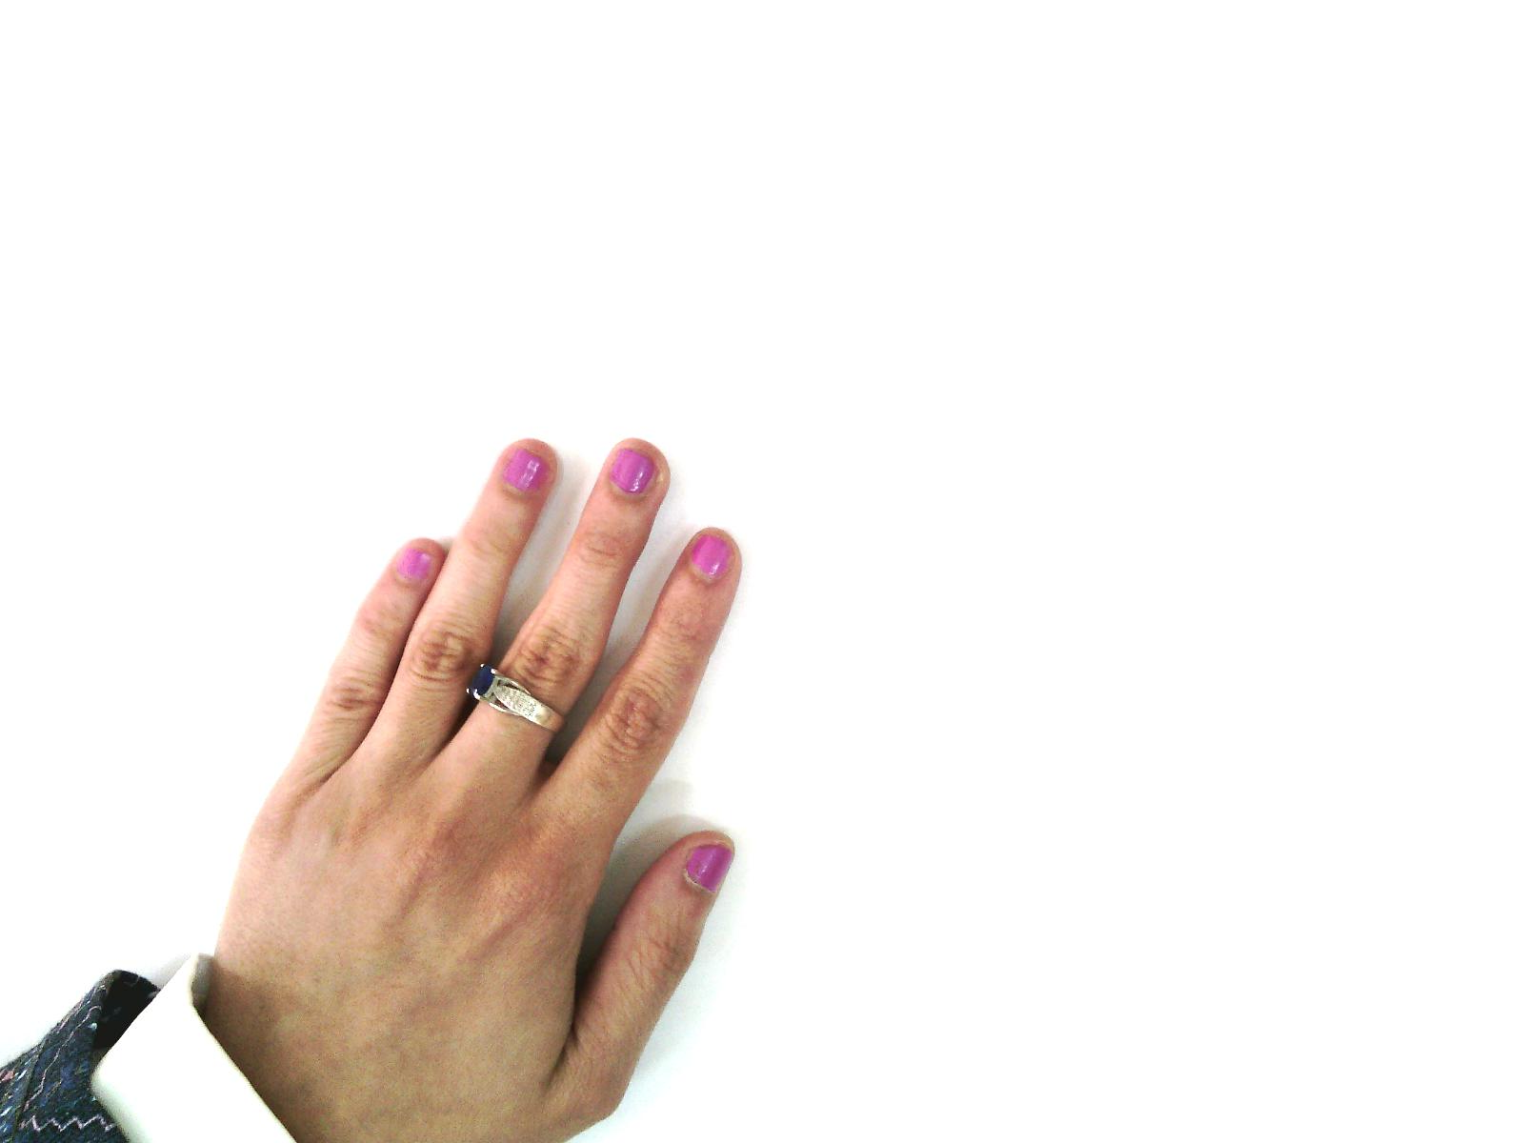
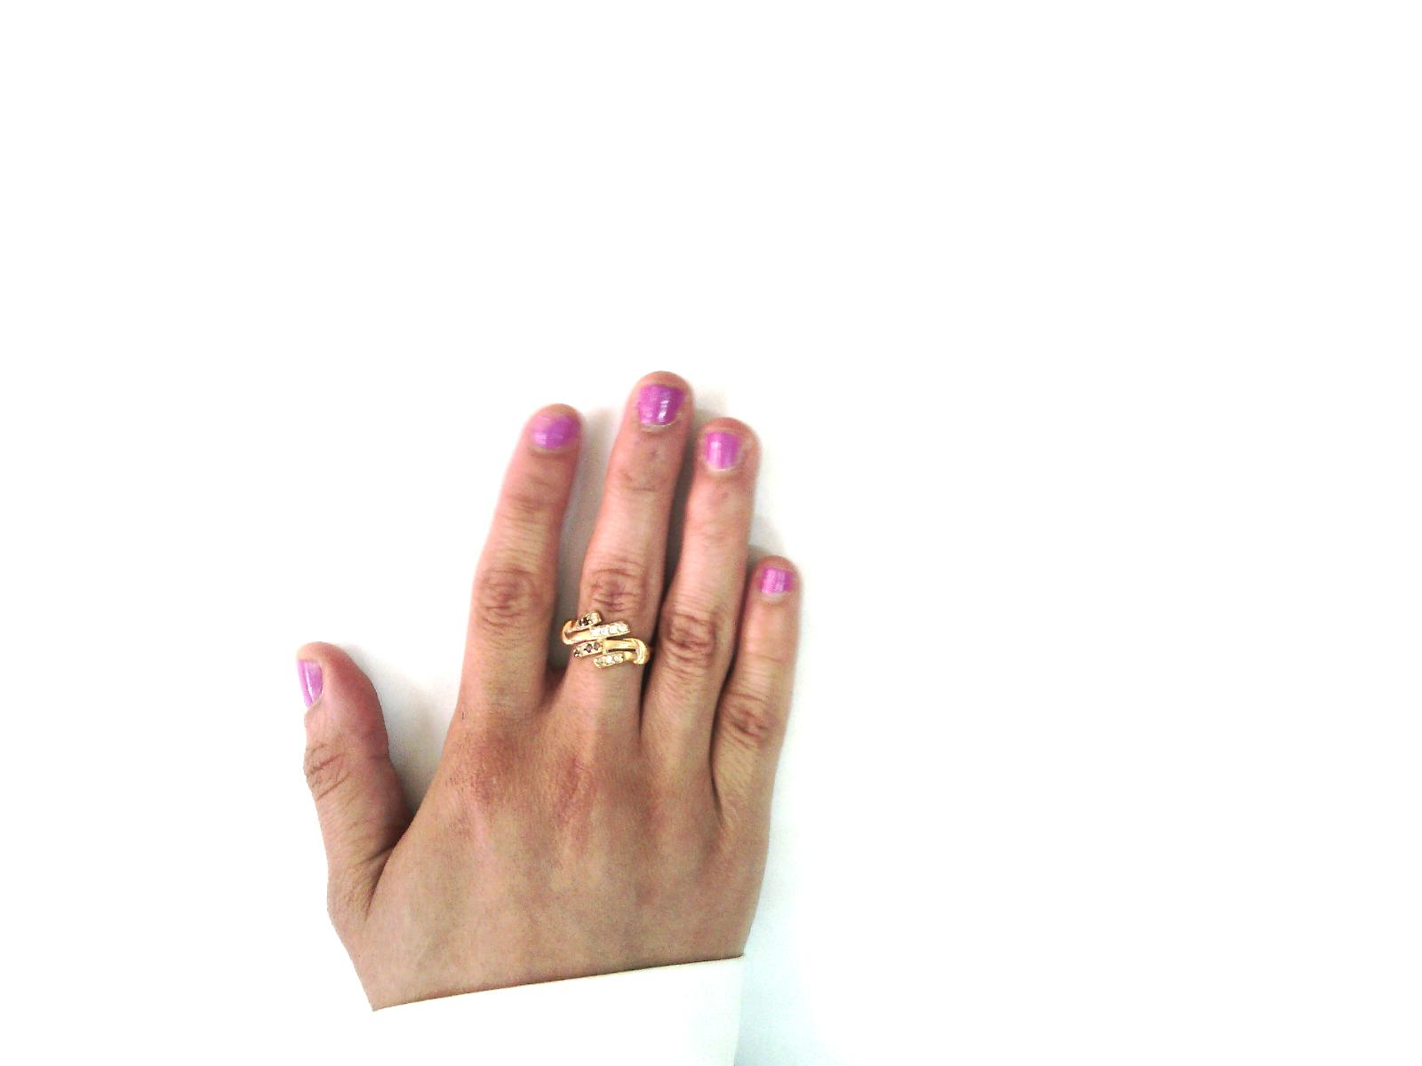
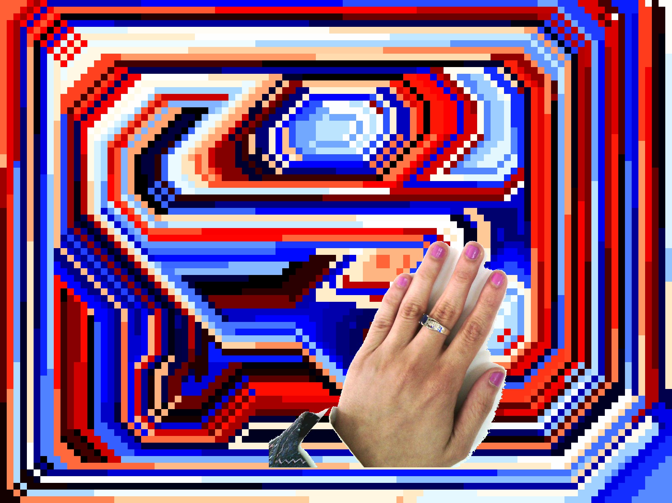
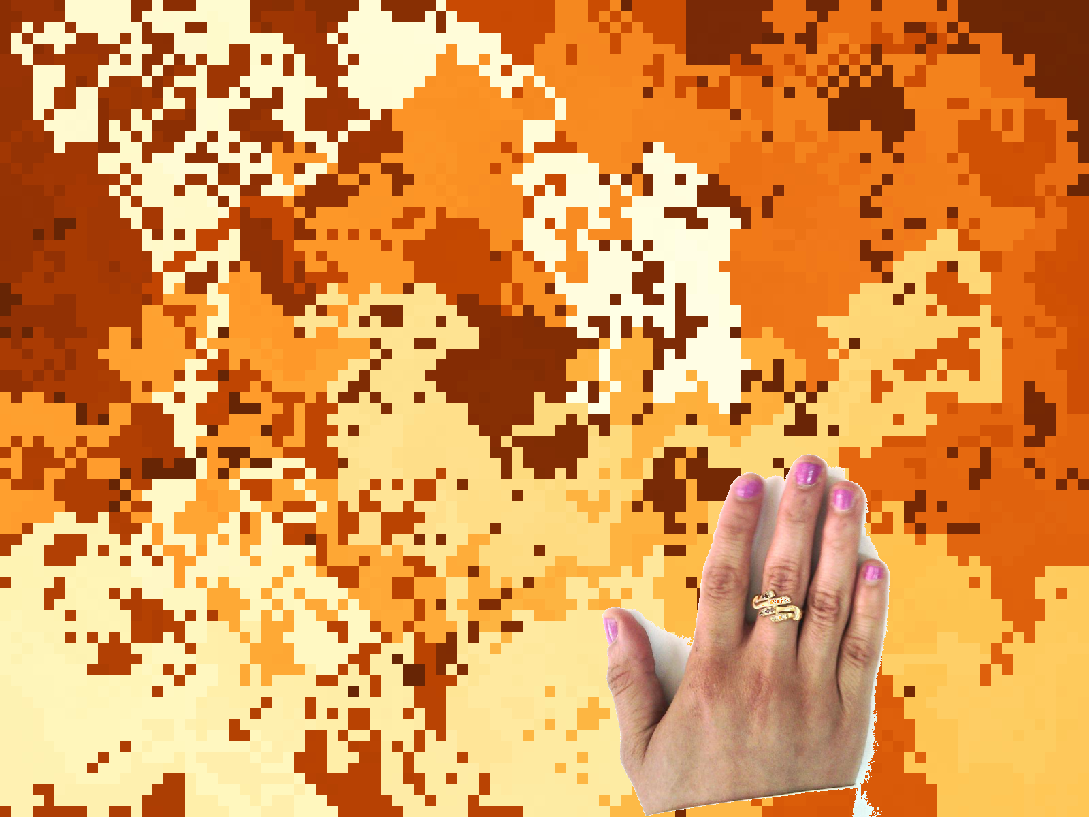
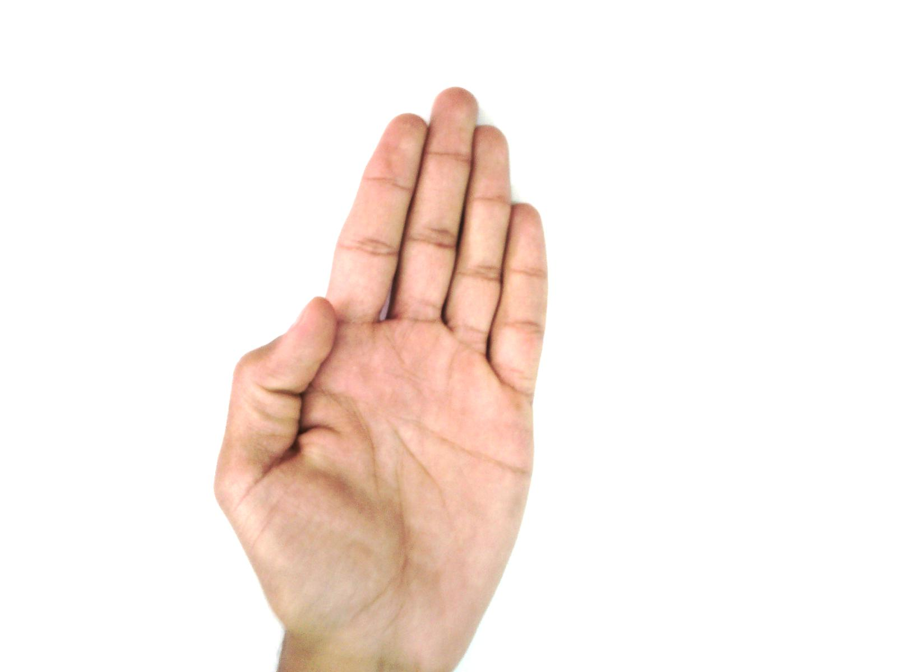
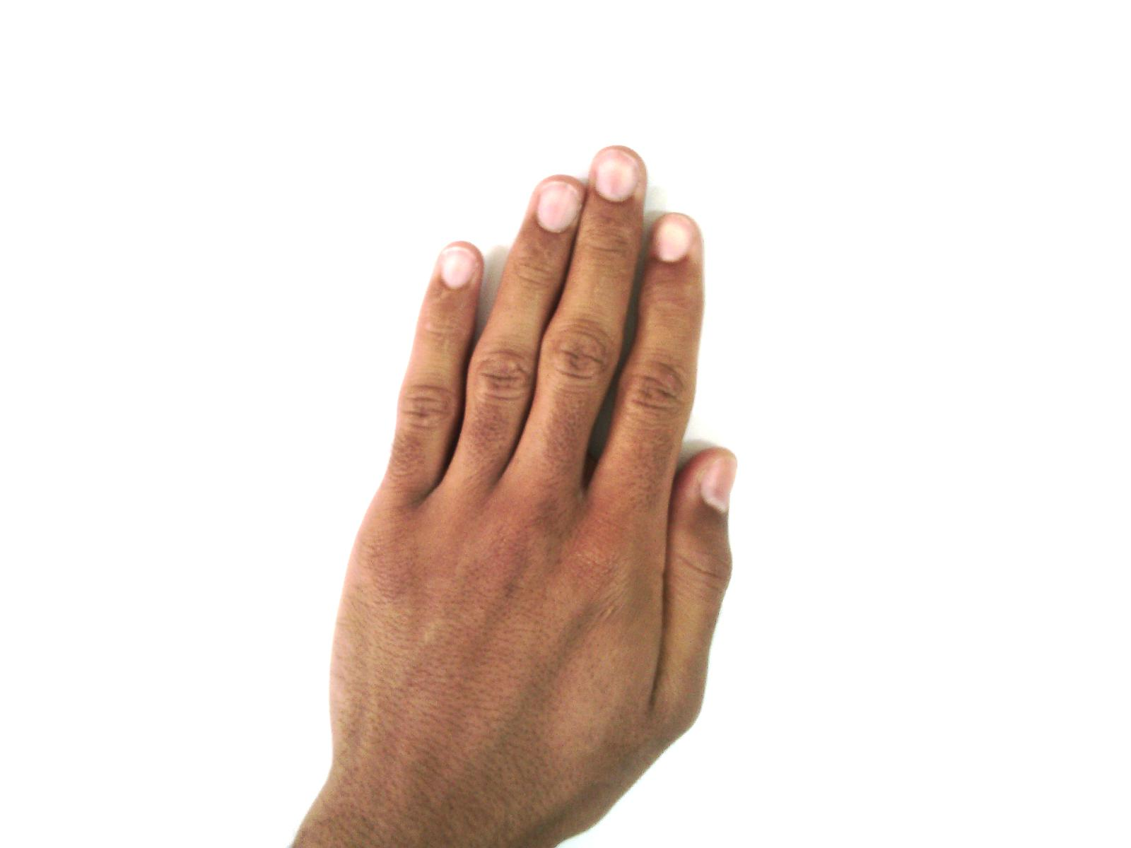
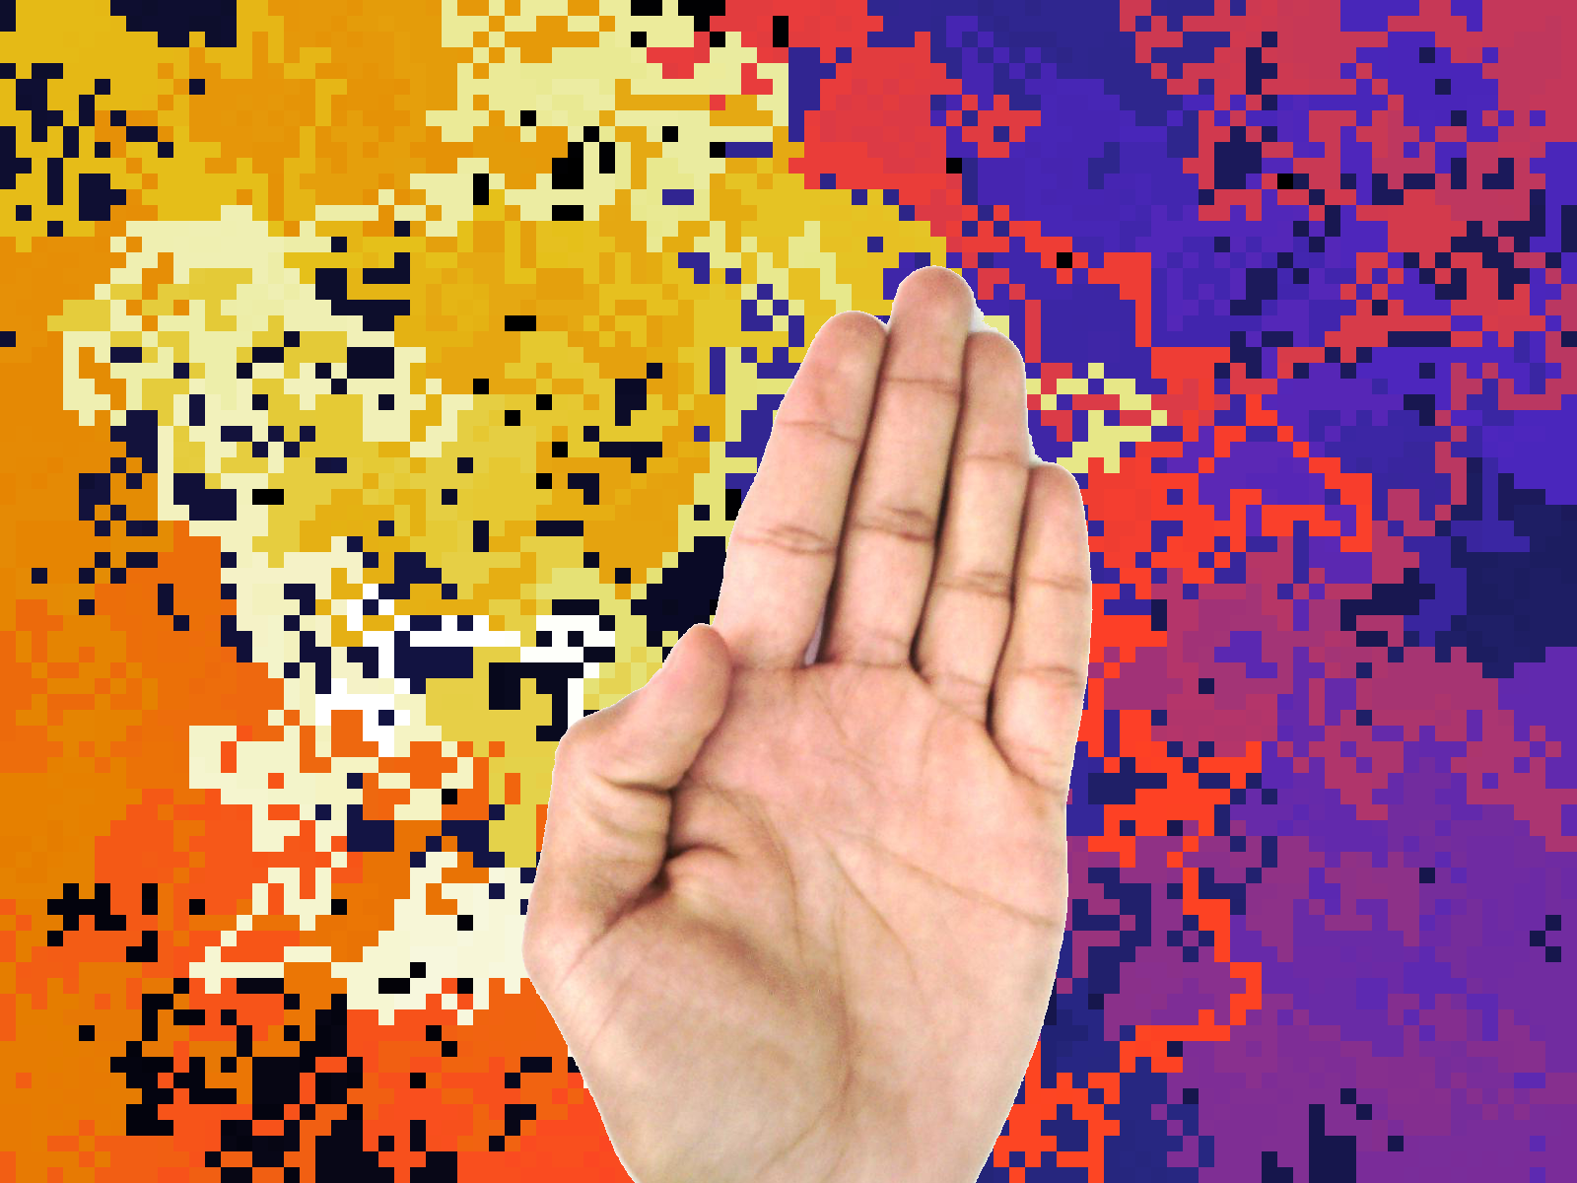
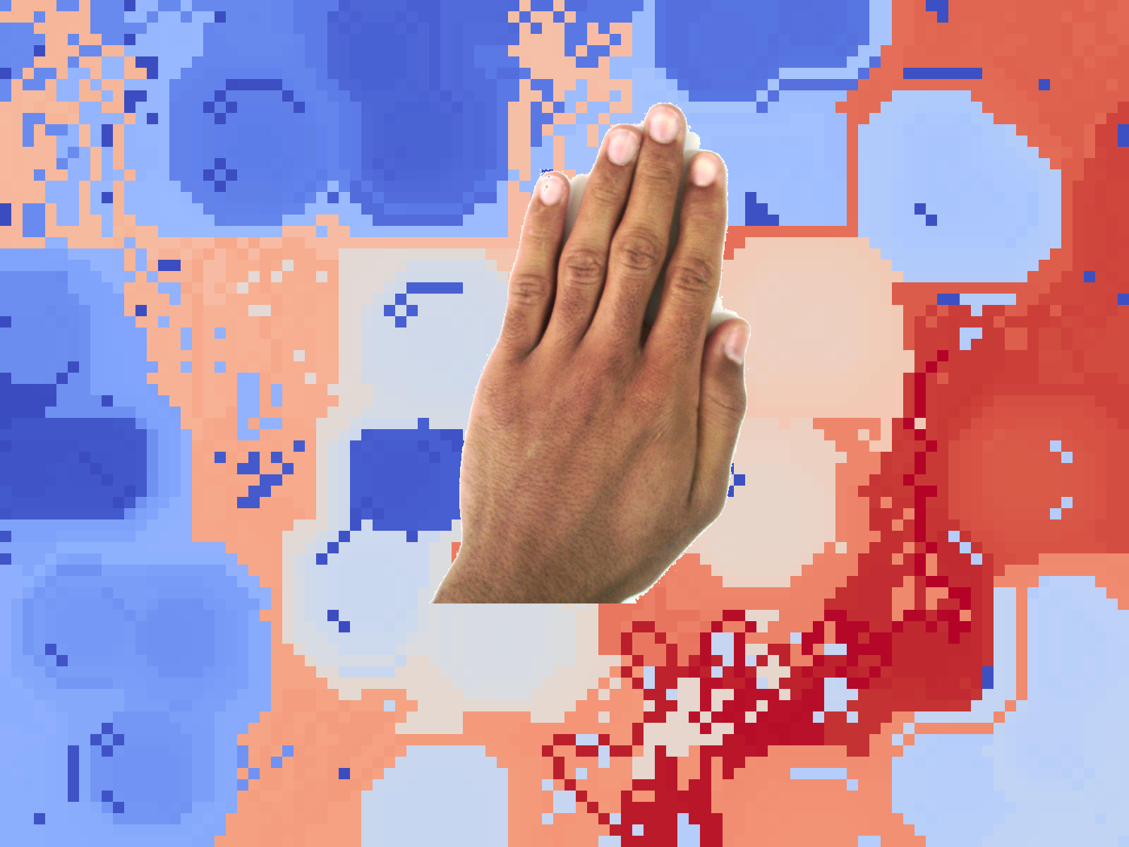


Slide 29
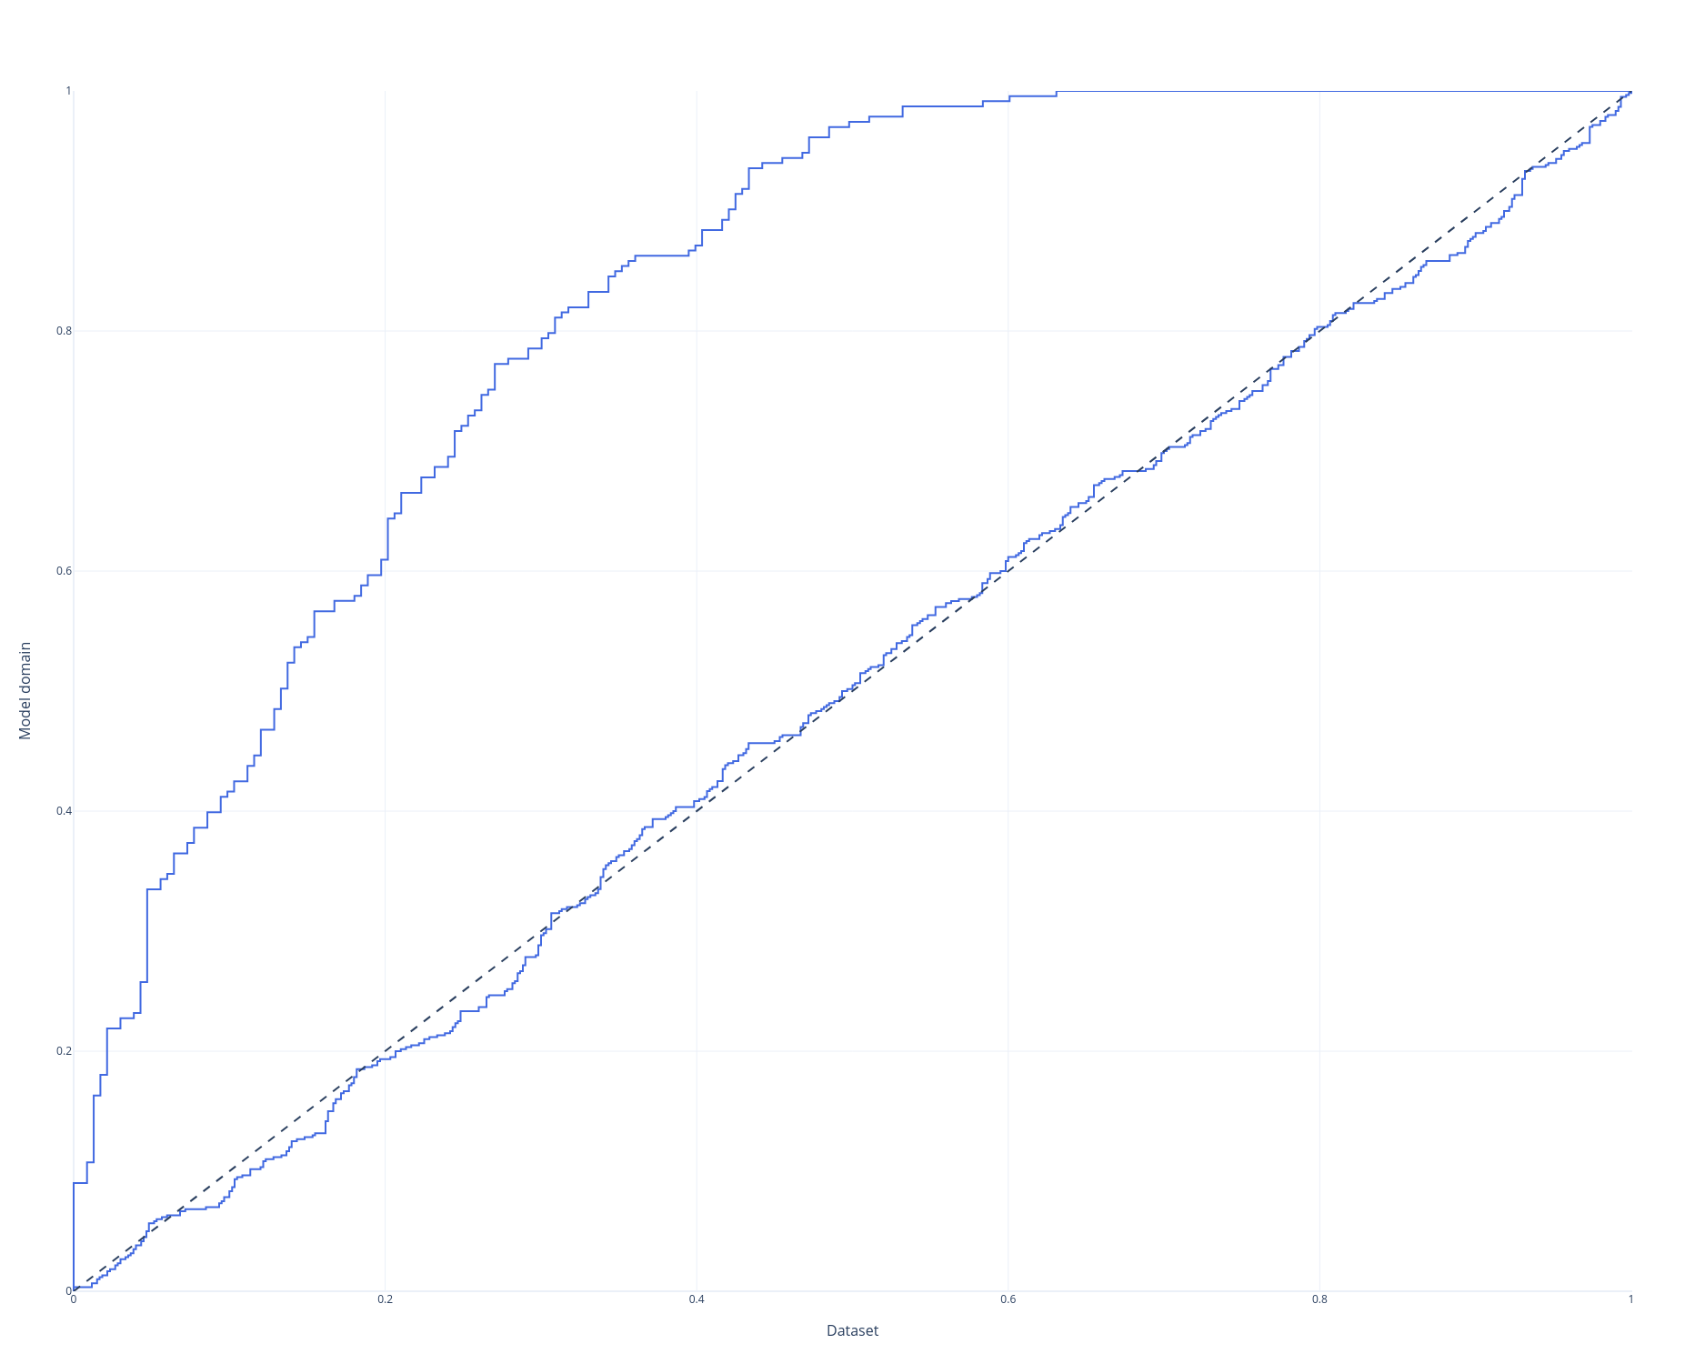
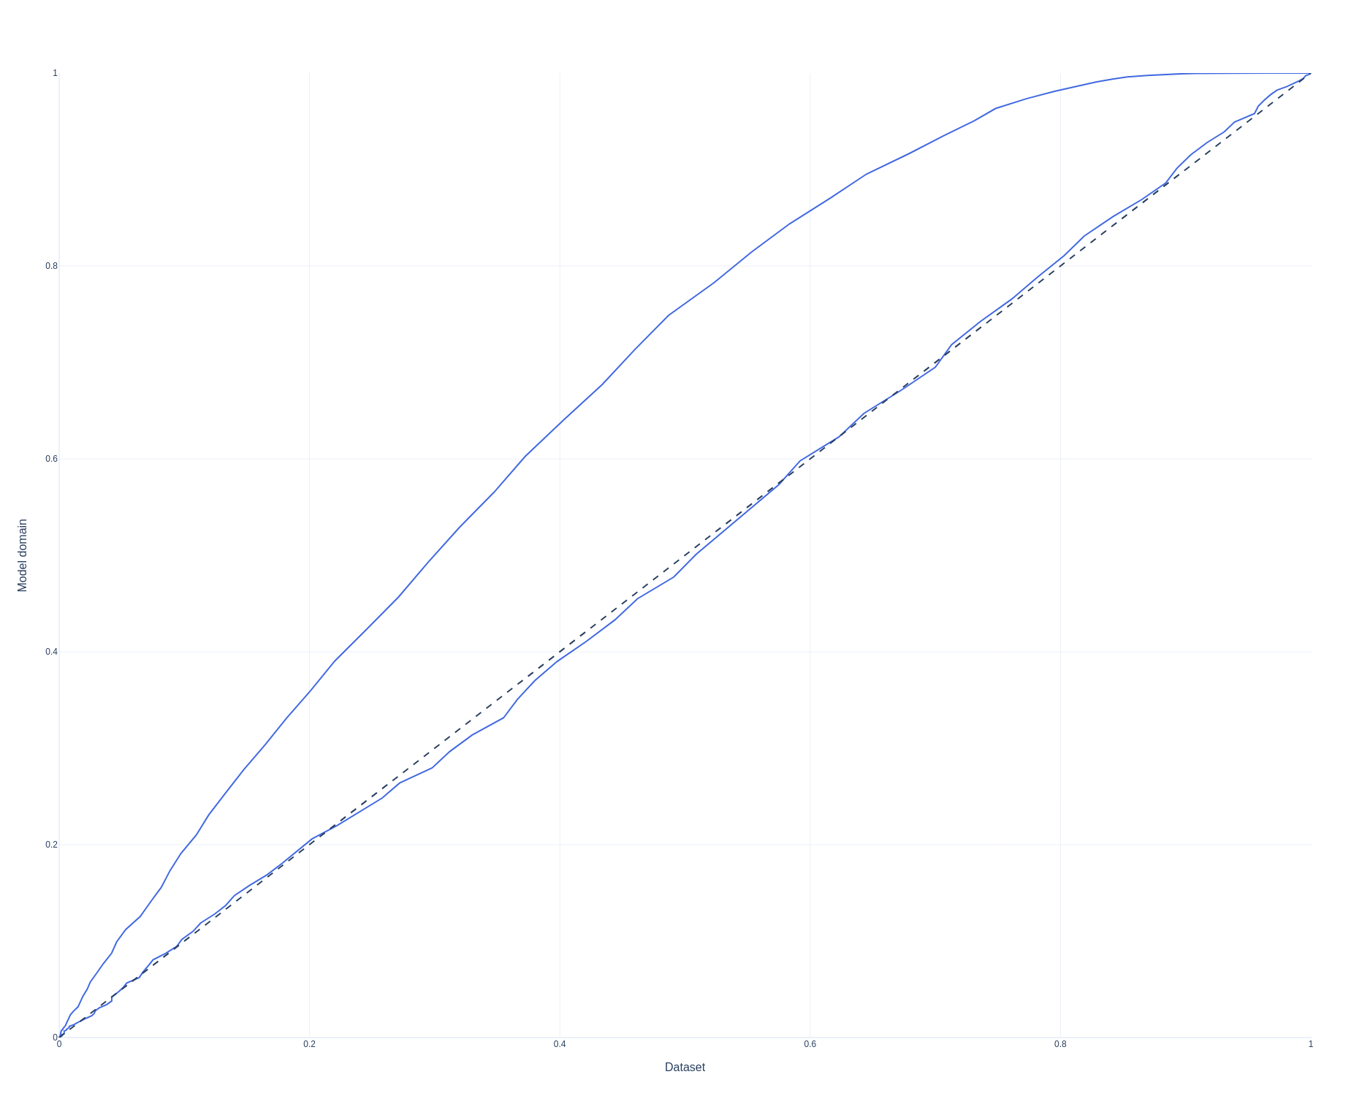
Before and after Hands processing
White background
random background
Faces performance on dorsal right hands
Faces performance on both hands

Slide 30
Experiment 1 – methods
Experiment 1.1:
3 DCNNs were trained with Resnet50 architecture on dataset 3 domains
Faces
Objects
Hands both
Each dataset contained 100 identities with 100 images per class.
To test performance on the same/different classification task: 2400 pairs of same/different pairs were randomly sampled from the validation set (equal number of same and different)
The 2400 pairs where split into 30 batches, each contained same number of same and different.

Slide 31
Experiment 1 – methods
Experiment 1.1:
For each batch, I tested the performance of each CNN in upright vs. inverted configuration, and calculated ROC and AUC.
Finally, I calculated the mean and std of AUCs of all batches

Slide 32
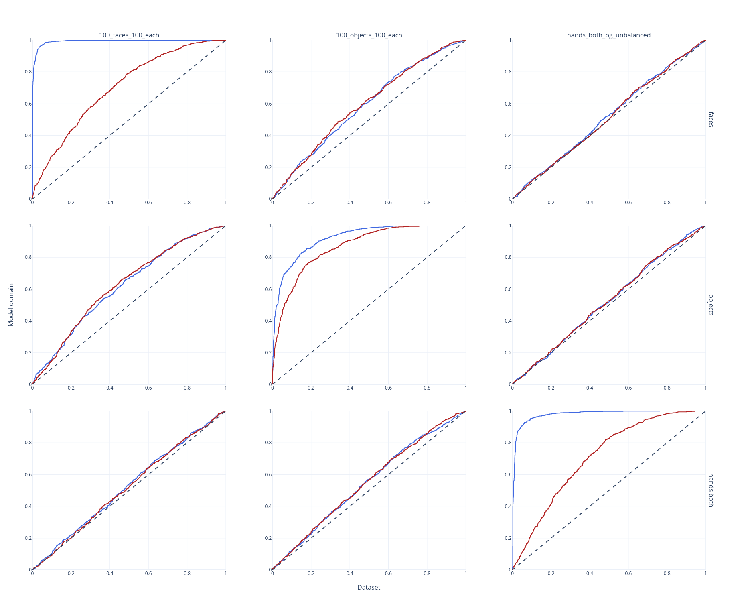
Experiment 1.1 – results
Upright
Inverted

Slide 33
Experiment 1.2 – methods
Experiment 1.2:
2 DCNNs were trained with Resnet50 architecture on dataset from 2 domains of the same individuals:
Hands both
Dorsal Right hands
Each dataset contained 50 identities with 100 images per class.
Rest of the methods are like experiment 1.1
I hypothesized that, in addition to inversion effect for same domain, “Hands both” net will also be good in classifying “dorsal right hands”.

Slide 34
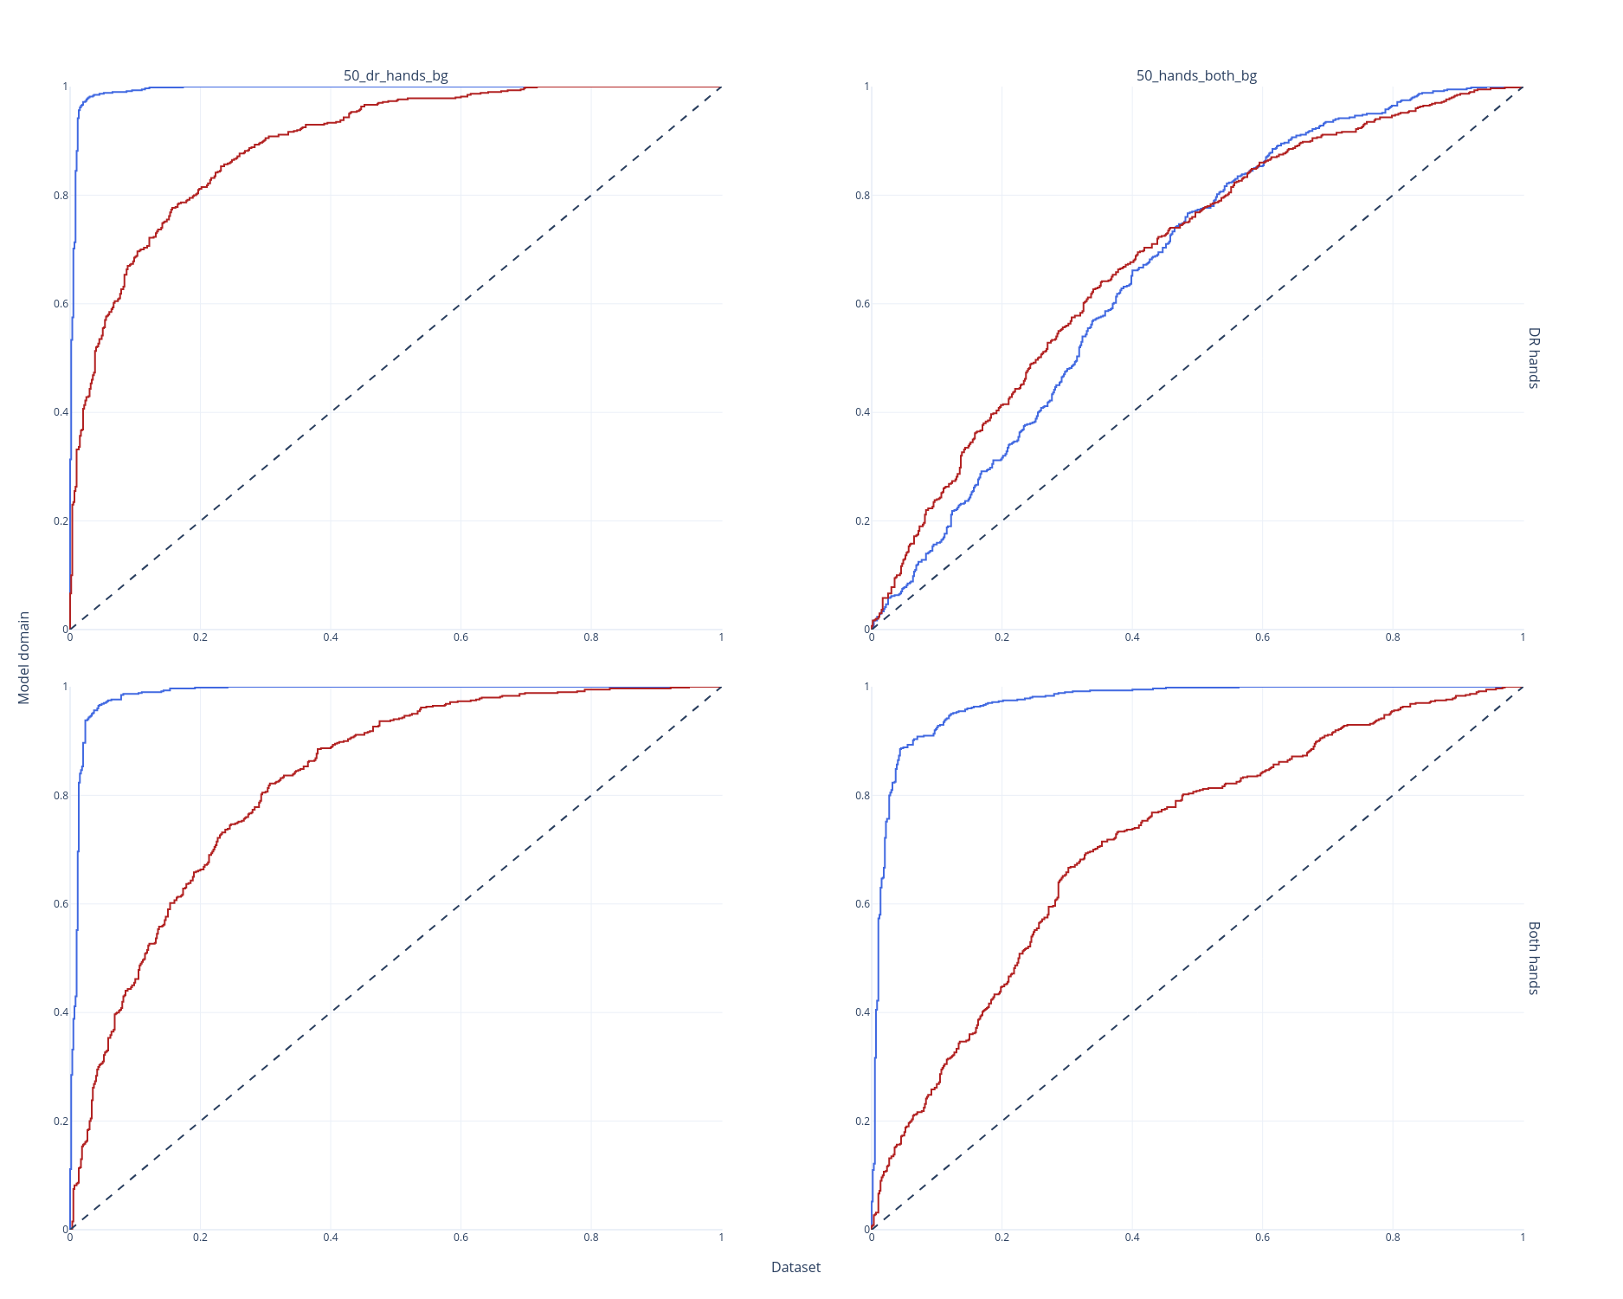
Experiment 1.2 – results
Upright
Inverted
Both Hands CNN
Tested on
Dorsal right pairs

Slide 35
Experiment 1 – Discussion
Inversion effect in objects was not strong
The importance of choosing the right dataset

Slide 36
Experiment 2 - Finetuning

Slide 37
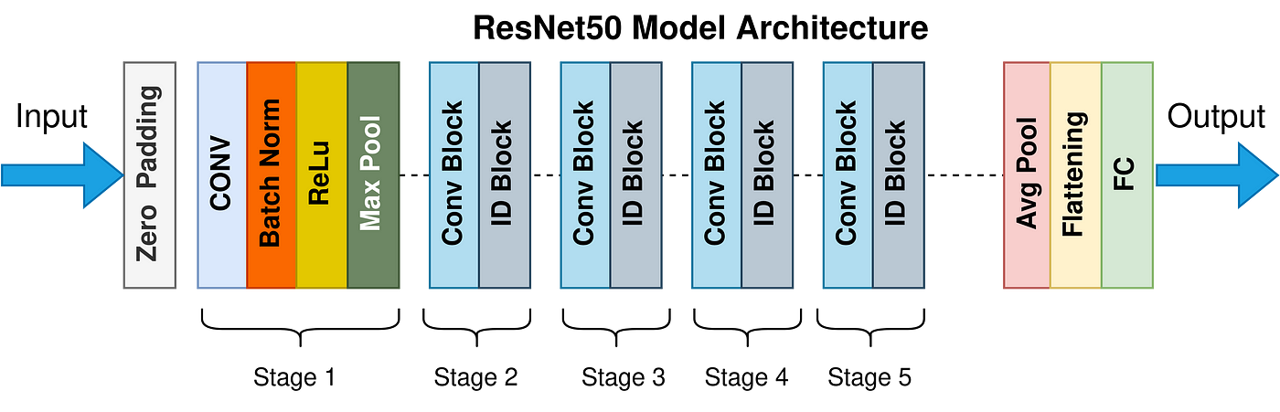
Experiment 2 - Methods
Two models were trained with Resnet50 architecture-
One model trained on faces
The other one trained on objects
I chose 7 different layers across the net and created 7 different fine-tuned networks for each pre-trained DCNN, by updating the weights of a different number of layers, starting with the top layer and freezing all other layers and then fine-tuning additional layers one by one up to the first layer.
AUCs were calculated similarly to experiment 1

Slide 38
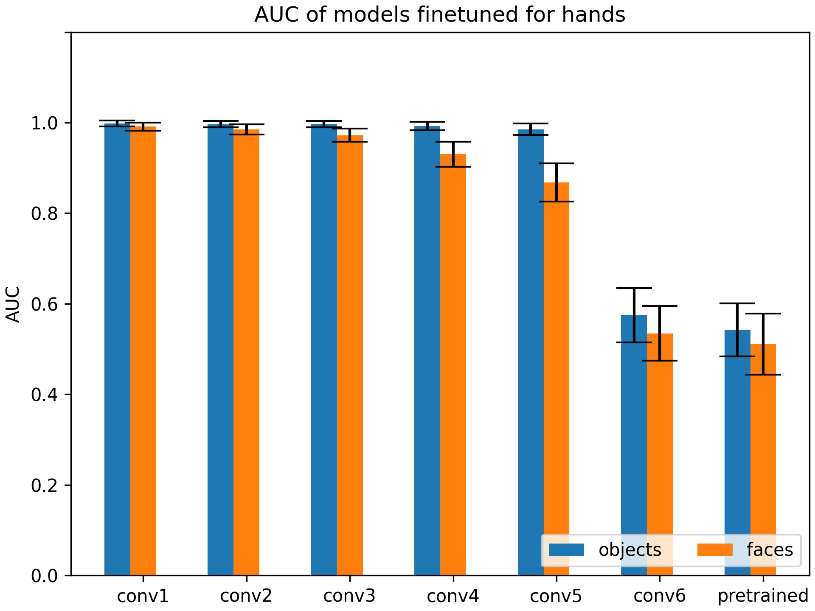
Experiment 2 – results

Slide 39
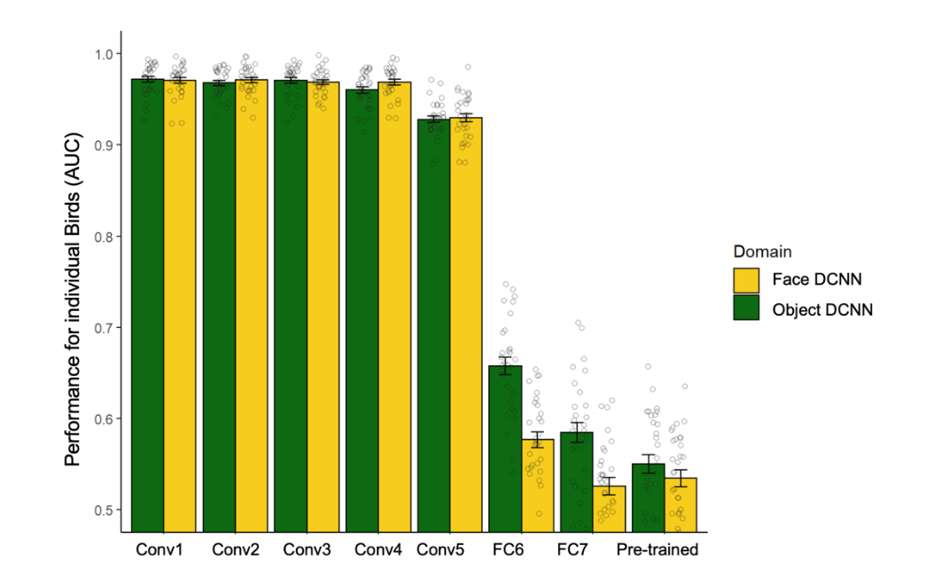
Experiment 2 – discussion
Results show that learning features of faces doesn’t generalize to other human organs.
Interestingly, results are similar to Yovel et al.’s experiment in a way that towards the end there’s a benefit to object.

Slide 40
Acknowledgment
Thanks to Idan Grosbard from Galit’s lab for writing the training infrastructure and representation extraction code.

Slide 41
Questions?

